Slide 1
Cost-Benefit Analysis
Modelling: indicators & Monetization
TYNDP/CBA SJWS 6 – 13 May 2014

Slide 2
To go beyond direct impact of the project
The definition of flows
  Modelling enables a more thorough assessment of the European gas system as considering simultaneously both supply and capacity constraints
  Flow pattern resulting from modelling can be analysed from both a quantitative and qualitative perspective
  Nevertheless the defined flow patterns are not to be seen as a forecast
  The incremental approach applied to modelling
  Under a given level of development of gas infrastructure and a set of assumptions defining supply and demand, the modelling tool defines the flow pattern:
    Balancing the demand of every node
    Keeping flow within capacity and supply constraints
    Minimizing the objective function considering gas supply, coal and CO2 costs
  The capacity increment of the project releases the constraint b) this can result in a flow pattern minimizing further the objective function

Slide 3
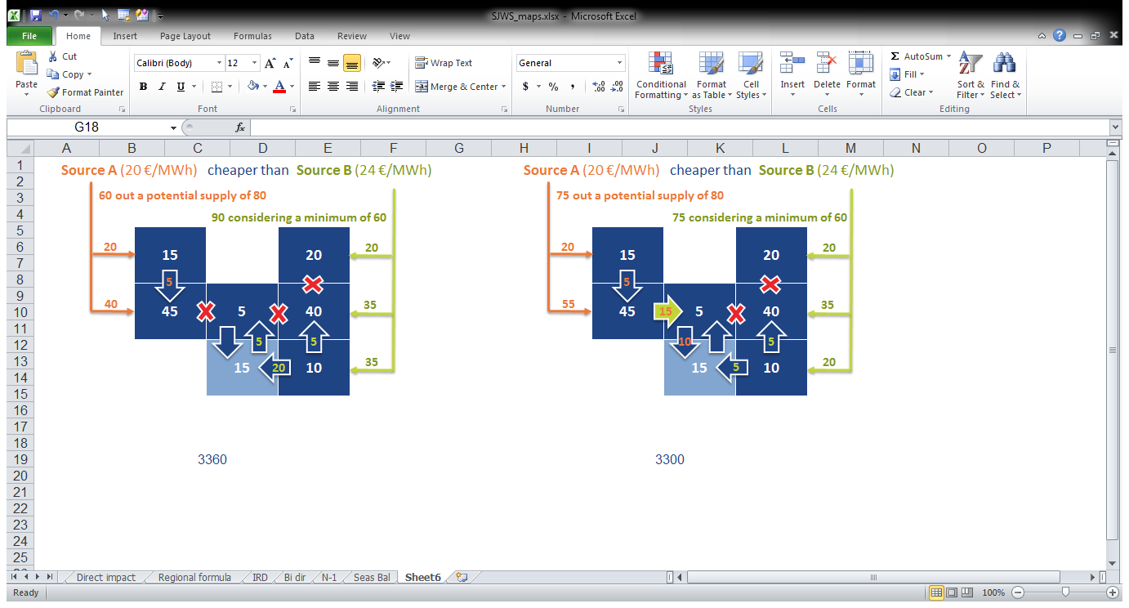
Example of indirect benefit
Situation before the project Situation with the project
  Improvement of the supply component of the objective function
  The project has enabled a further spread and higher use of the cheapest source
    Before the project: 60 x 20 + 90 x 24 = 3360 €
    After the project: 75 x 20 + 75 x 24 = 3300 €
  Capacity-based indicators would not have been able to identify benefit in country in light blue
Project benefit: 60 €

Slide 4
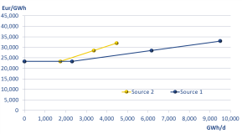
The modelling approach to monetization -1
1 year split into 4 differently long-lasting periods
Source 1
Source 2
Source 1 Summer
Source 2 Summer
Source 1 Winter
Source 2 Winter
Source 1 DC
Source 2 DC
Source 1 2W
Source 2 2W
A
B
A
B
A
B
A
B
C
C
C
C
Period 1
Summer average
183 days
Period 2
Winter average
167 days
Period 3
Design Case
1 day
Period 4
2Week peak
14 days
Total Winter: 182 days

Slide 5
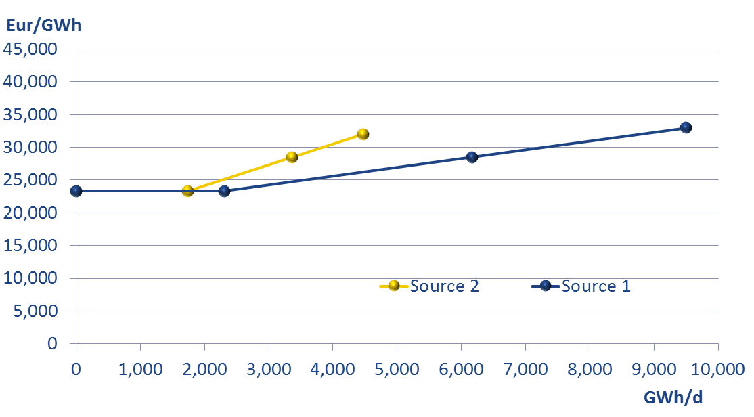
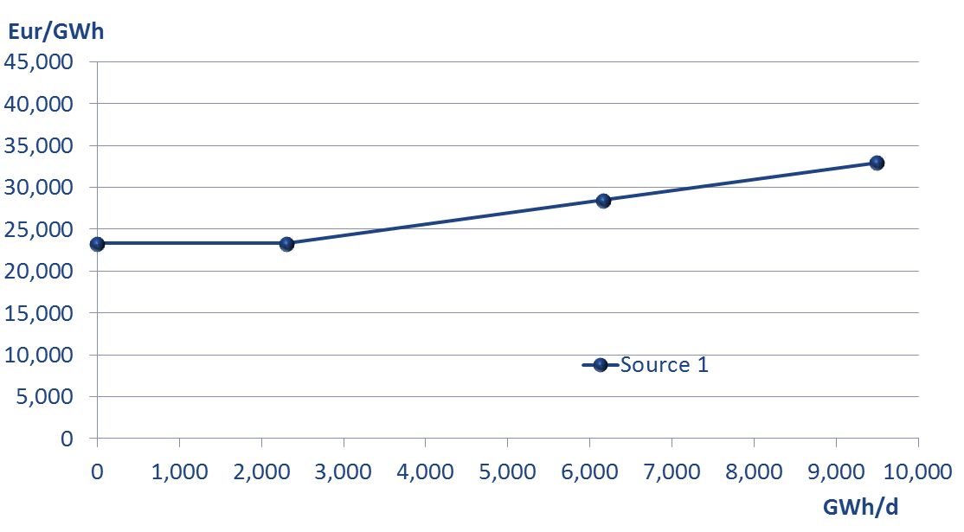
Temporal optimization of the year
1 year split into 4 differently long-lasting periods
Source 1
Source 1 Summer
Source 1 Winter
Source 1 DC
Source 1 2W
Summer
Winter
2W
DC
One Supply curve per source – different price levels in the different periods given by the different demand levels.
Different flow constraints will define the potential range for each period.

Slide 6
Modelling of seasons are interlinked
1 year split into 4 differently long-lasting periods
Source 1
Source 2
Source 1 Summer
Source 2 Summer
Source 1 Winter
Source 2 Winter
Source 1 DC
Source 2 DC
Source 1 2W
Source 2 2W
A
B
A
B
A
B
A
B
C
C
C
C
AS
AW
DC
2W
UGS A
UGS B
The link between the different periods is given by the use of UGS.

Slide 7
Gas flow from season to the other through UGS
1 year split into 4 differently long-lasting periods
Source 1
Source 2
Source 1 Summer
Source 2 Summer
Source 1 Winter
Source 2 Winter
Source 1 DC
Source 2 DC
Source 1 2W
Source 2 2W
A
B
A
B
A
B
A
B
C
C
C
C
AS
AW
DC
2W
The source 2 stored in UGS A during Summer reach A and then C during the Winter
Source 2 reaching directly node A during summer
UGS A
UGS B
The different demand levels in the different cases derive in different flow patterns.

Slide 8
The monetized layers
Costs follow the flow pattern
The model minimizes the total costs for Europe (“Total EU bill”)
The Total EU bill includes:
  Supply costs:
    Import costs
    National production
  Coal costs
  CO2 costs
    CO2 from coal
    CO2 from gas
  Infrastructure costs:
    UGS costs (injection + withdraw)
    LNG infrastructures costs
    Transportation costs
C_{s}
C_{IP}
C_{C}
C_{Ec}
C_{Eg}
C_{u}
C_{L}
C_{t}
A change in the definition of the supply curves or in the unitary costs would involve a change in the resulting flow patterns and Total EU bill.

Slide 9
Where costs are measured - 1
C_{s}
Cost of gas supply: Imports
C_{t}
Cost of transport
Source 1
LNG
Source 2
C_{u}
Cost of UGS
C_{L}
Cost of LNG infrastructures
C_{s}
C_{s}
C_{s}
C_{s}
C_{s}
C_{s}
C_{s}
C_{s}
Source 1 Summer
Source 2 Summer
Source 1 Winter
Source 2 Winter
Source 1 DC
Source 2 DC
Source 1 2W
Source 2 2W
C_{L}
C_{L}
C_{L}
C_{L}
A
B
A
B
A
B
A
B
C_{t}
C_{t}
C_{t}
C_{t}
C
C_{t}
C
C_{t}
C
C_{t}
C
C_{t}
C_{u}
AS
AW
C_{u}
C_{u}
DC
2W
C_{u}
C_{u}
C_{u}
C_{u}
C_{u}
UGS A
UGS B
The resulting flow pattern minimizes the total cost for the system.

Slide 10
Where costs are measured - 2
C_{s}
Cost of gas supply: Imports
C_{IP}
Cost of gas supply: Indigenous/National production
Source 1
LNG
Source 2
C_{t}
Cost of transport
Source 2
Indigenous prod.
Cost of UGS
C_{u}
C_{L}
Cost of LNG infrastructures
C_{s}
C_{s}
C_{s}
C_{s}
C_{s}
C_{IP}
C_{s}
C_{IP}
C_{s}
C_{IP}
C_{IP}
C_{s}
Source 1 Summer
Source 2 Summer
Source 1 Winter
Source 2 Winter
Source 1 DC
Source 2 DC
Source 1 2W
Source 2 2W
C_{L}
C_{L}
C_{L}
C_{L}
A
B
A
B
A
B
A
B
C_{t}
C_{t}
C_{t}
C_{t}
C
C_{t}
C
C_{t}
C
C_{t}
C
C_{t}
C_{u}
AS
AW
C_{u}
C_{u}
DC
2W
C_{u}
C_{u}
C_{u}
C_{u}
C_{u}
UGS A
UGS B
The resulting flow pattern minimizes the total cost for the system.

Slide 11
Focus on power generation
Coal
C_{s}
Cost of gas supply: Imports
C_{IP}
Cost of gas supply: Indigenous/National production
C_{t}
Cost of transport
C_{C}
C_{u}
Cost of UGS
C_{Ec}
C_{L}
Cost of LNG infrastructures
A
Electricity node
C_{C}
Cost of coal supply
C_{Ec}
Cost of emissions from Coal
C_{Eg}
Cost of emissions from Gas
C_{Eg}
Gas demand

Slide 12
An actual example
Addition of a project: change in flow patterns
Example: Reference case, Green Scenario, Winter average day
Addition of a project: change in the European bill
Below flow patterns only serve the purpose of illustrating the methodology and is in no way an assessment of project value
FID
FID + LNG HR
FID
FID+LNGHR

Slide 13
Split of European bill per country
From European level to country one
  The change in objective function resulting from the project implementation provides directly the monetization of project benefits at EU level
  The methodology to split such benefits per country is still under testing
  The comparison of benefits and investment cost per country will provide the net impact for each country
  Form of the results
  For each scenario and case, the TYNDP-step will provide the following table:
  PS-step will result in the same table, which once compared with the TYNDP-step one will provide the incremental benefit per country
Bn € | 2015 | 2020 | 2025 | 2030 | 2035
Country A | 200 | 210 | 215 | 220 | 215
Country B | 100 | 101 | 102 | 103 | 104
…
Country Z | 150 | 150 | 140 | 150 | 155

Slide 14
Example of calculation

Slide 15
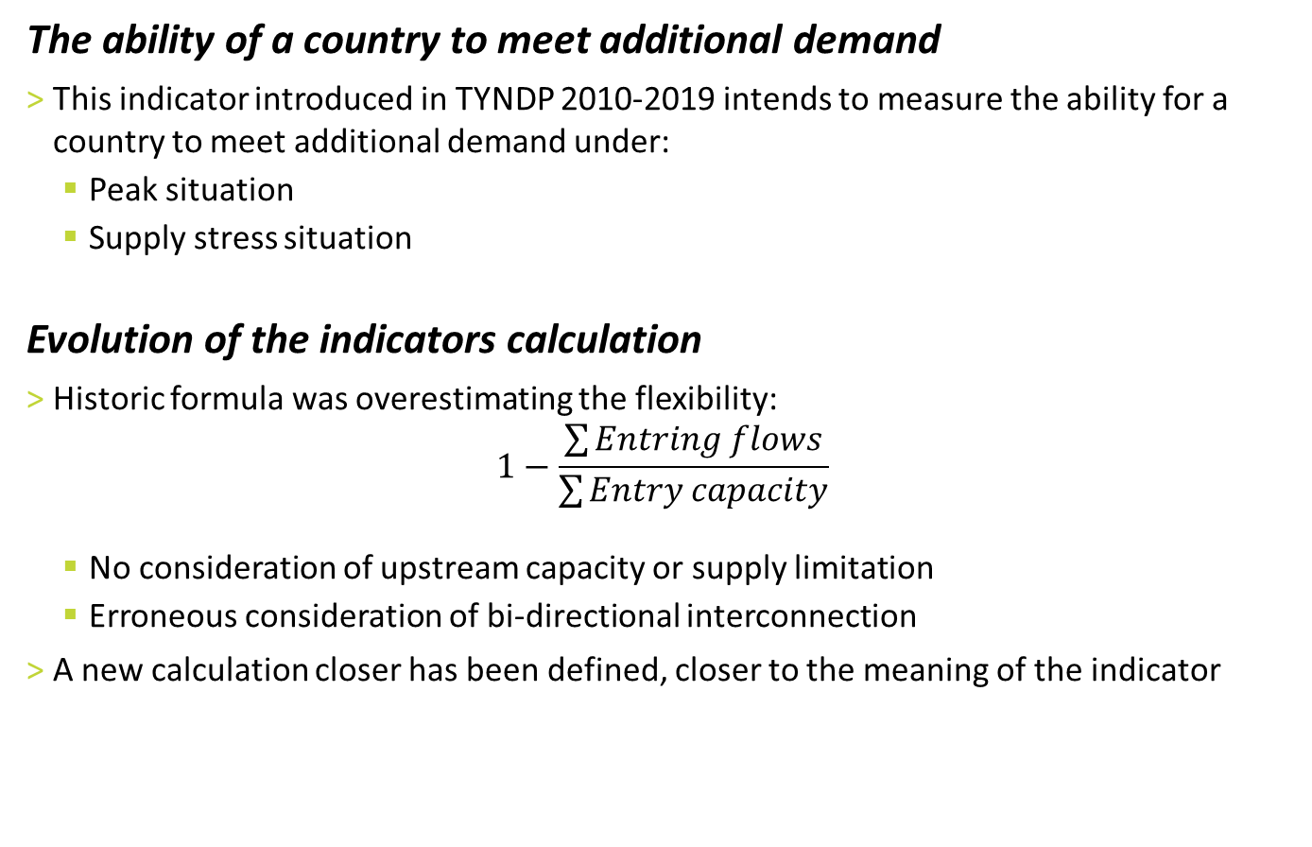
Remaining Flexibility
The ability of a country to meet additional demand
  This indicator introduced in TYNDP 2010-2019 intends to measure the ability for a country to meet additional demand under:
    Peak situation
    Supply stress situation
  Evolution of the indicators calculation
  Historic formula was overestimating the flexibility:
  $$1−\frac{\sum{Entring flows}}{\sum{Entry capacity}}$$
    No consideration of upstream capacity or supply limitation
    Erroneous consideration of bi-directional interconnection
  A new calculation closer has been defined, closer to the meaning of the indicator
Europe is modelled with an alternative increase of the demand in each country, the maximum relative increase of demand defines the Remaining Flexibility

Slide 16
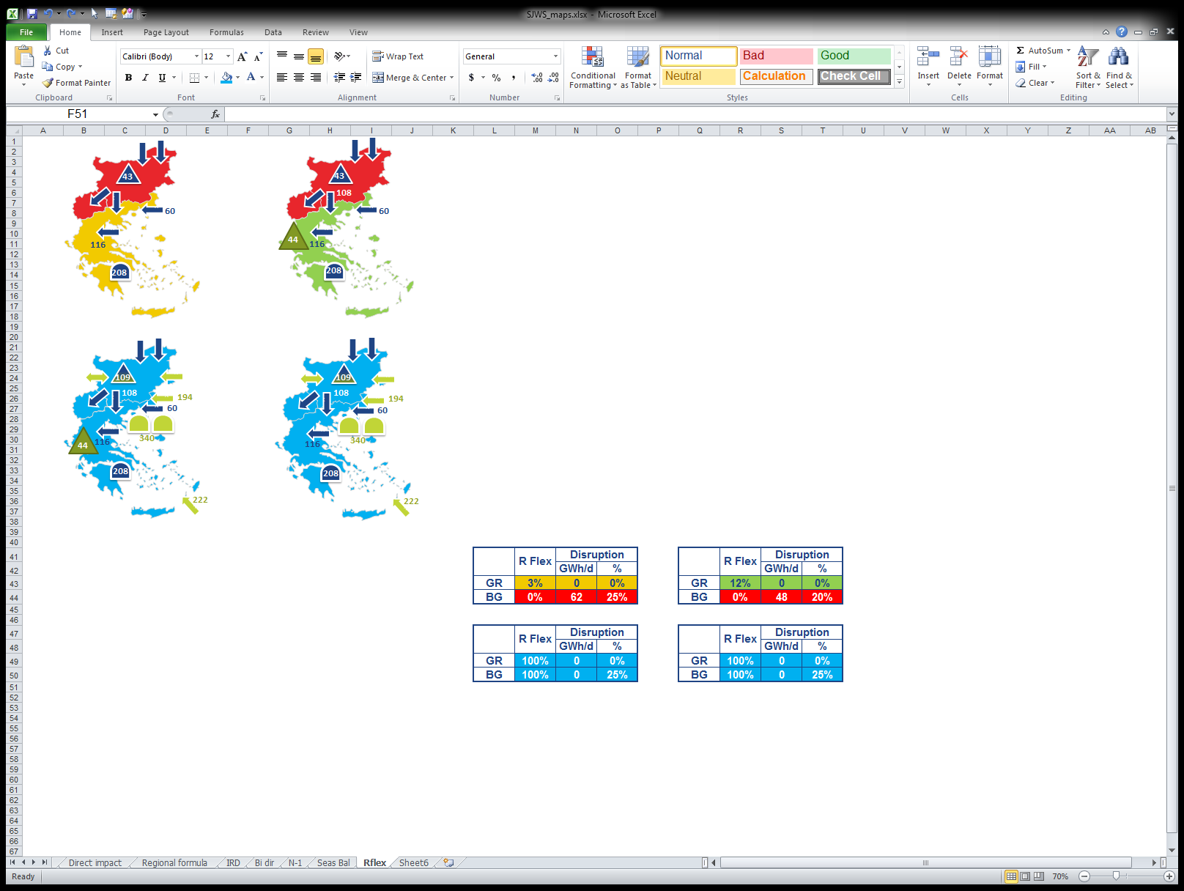

Remaining Flexibility – UGS Kavala
Application
  Modelling of Ukraine disruption under 1-day Design Case peak
Calculation of the indicator only serves the purpose of illustrating the methodology and is in no way an assessment of project value
TYNDP-step
PS-step
Project impact
under
Low Infra. Scenario
+9% R. Flex in GR
+5% of demand cover in BG
High Infra. Scenario
Beyond indicator range
Low
Infra. Scenario
Low
Infra. Scenario
+ project
High
Infra. Scenario
High
Infra. Scenario
- project

Slide 17
Price convergence
The relative move of the price of 2 zones
  This indicator is based on the marginal price of each zone being the price of the additional supply that would be required to serve one unit more of demand in that zone
  The implementation of a project can result in:
    Spatial convergence, being 2 countries under a given climatic case see their marginal prices becoming closer
    Temporal convergence, being one country having its winter and summer marginal prices becoming closer
€
Dem
Dem
Marginal price
Q

Slide 18
Price convergence – UGS South Kavala & GIPL
Calculation of the indicator only serves the purpose of illustrating the methodology and is in no way an assessment of project value
UGS Kavala compared to Low Infra. scenario
GIPL compared to High Infra. scenario

Slide 19
Supply Source Dependence
Identification of countries highly dependent on a single source
  Assessment carried out through out the year under the minimization of the source on which dependence is investigated
  As for other indicators, within a given region, the relative dependence of one country compared to the other may change according actual repartition
  Should it be about physical access or “contractual one”
  The first is based on supply shares defined by the flow pattern resulting from modelling
  The second is more related to the ability of a country to benefit from a decrease of its marginal price resulting from a project implementation (this could happen without physical access)
Supply Source Diversification

Slide 20
Olivier Lebois
Business Area Manager, System Development
olivier.Lebois@entsog.eu

