Slide 1
Cost-Benefit Analysis
Economic Performance Indicators
TYNDP/CBA SJWS 6 – 13 May 2014

Slide 2
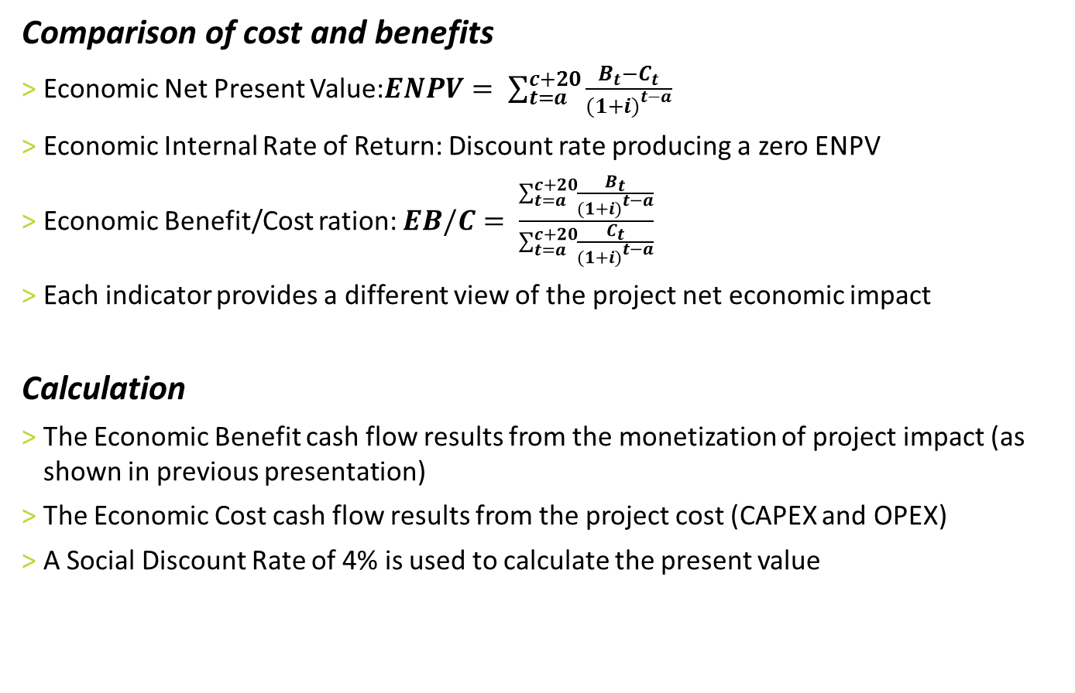
Synthetic indicators…
Comparison of cost and benefits
  Economic Net Present Value:$ENPV= \sum_{t=a}^{c+20}{\frac{B_{t}−C_{t}}{{(1+i)}^{t−a}}}$
  Economic Internal Rate of Return: Discount rate producing a zero ENPV
  Economic Benefit/Cost ration: $EB/C= \frac{\sum_{t=a}^{c+20}{\frac{B_{t}}{{(1+i)}^{t−a}}}}{\sum_{t=a}^{c+20}{\frac{C_{t}}{{(1+i)}^{t−a}}}}$
  Each indicator provides a different view of the project net economic impact
  Calculation
  The Economic Benefit cash flow results from the monetization of project impact (as shown in previous presentation)
  The Economic Cost cash flow results from the project cost (CAPEX and OPEX)
  A Social Discount Rate of 4% is used to calculate the present value

Slide 3
…but still not resulting in a project ranking
Sensitivity to assumptions
  Resulting in a single value, the indicators may give the impression they can be directly used to rank projects but they have the same link to assumptions as any other outputs from the methodology:
    Benefits are dependent from demand and supply assumptions
    Costs are dependent from CAPEX, OPEX and commissioning date accuracy
  The firsts are mitigated through the scenario approach and the seconds by a sensitivity-study on project data
  Therefore the PS-CBA step results in one value per indicator and case (around 5) plus the variation linked to project data
  Possible aggregation
  The ENPV and EB/C ratios calculated at case level can from a mathematical point of view be easily aggregated but:
    Aggregation of cases will dilute project benefits
    Hide the link between results and input data

Slide 4
Example of calculation on a fake project

Slide 5
Guidance on the interpretation of results
What Regional Groups and NRAs can get from the results
  A high degree of comparability between projects (same methodology same data)
  A good understanding of project impacts and when they could materialized
  An idea of the robustness of benefits if they appear in a large range of cases
  This knowledge can be obtained if result analysis is not limited to aggregated EPIs
  A methodology to inform not to decide
  Readers of the ESW-CBA results will have a good understanding of the impact of each project but the methodology cannot forecast the occurence of coal, gas and CO2 prices nor the evolution of demand
  Therefore decision-makers will need to have a political vision of the evolution of such parameters in order to select PCIs
  Uncertainty about the materialization of conditions favorable to project benefits and competition between certain projects will mean that the backing of project by financial commitment from the market is the most robust way to move from the selection to the commissioning

Slide 6
Olivier Lebois
Business Area Manager, System Development
olivier.Lebois@entsog.eu

