Slide 1
Projects and topology
TYNDP 2017 SJWS III
@ Energy Community - Vienna
09 February 2016
How does your data submission translate into a Project in the topology
Ádám Balogh
Adviser

Slide 2
Content
Recap on the previous SJWS
How does Data Submission translate into a Project
Validation Rules and Monitoring Activities
Data Portal Project General Information
Data Portal Interface live presentation
  Basic functionality – Create/Modify/Cancel/Submit Project, Submit Increment for existing/new Point
Point and Operator creation forms
Self-assessment of investment needs

Slide 3
Refresh on the SJWS #1
Recap on the previous SJWS – The Data Collection schedule
  Projects can be submitted within the Project Submission timeframe
  During Data Consistency Check timeframe, only capacity modifications can be made for non-matching capacities
Coordination of Promoters shall start well before the Data Collection.
Fully non-coordinated Projects will not be modelled – Lesser of Rule

Slide 4
How does data submission translate into a Project modelling
There is an already existing network topology; available information:
    Which Point
    What capacities
    Which operators
Point Y
15
A
B
20
15
5
10
5

Slide 5
How does data submission translate into a Project
And a Project is submitted between countries B and C...
  The minimum information to enable the assessment of the Project are seen below:
    Point Name (if necessary create new point); Capacities; Commissioning Date; FID Status; Maturity
Point X between country B and C
25 from 2023
A
C
Missmatch
Submission 1
Promoter B
From 2021
50
25
Submission 2
Promoter C
From 2023
B
Missmatch
40
35
35 from 2023

Slide 6
Data Portal general information
Principles in the system
  Online web-portal with user authentication – note the credentials update process
  For projects already submitted to ENTSOG, questionnaires will already include latest version of project data (nevertheless Promoter will have to resubmit the Project)
  Portal is permanently online and information can be updated at any time, however a deadline system is defined for inclusion in specific publications
  Promoters can fill in their questionnaires in multiple sessions, with the portal saving the unfinished version as a draft
  Segregation of the data : project promoters only have access to their data and eventually data that concern their network (adjacent capacity increments)
  Excel is not used as a data entry mechanism as it is difficult to enforce strict data quality mechanisms
  It is now easily possible to export the project information in Excel

Slide 7
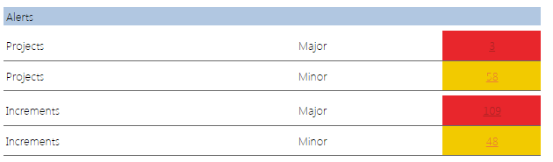
Validation Rules
A rule applied on the submitted data (Project data or Incremental capacity data) – Examples:
  Commissioning date should be
  in the future but within the TYNDP time horizon
  The value of an increment shall be X>0 GWh/d
  A Project with FID in the past cannot be Non-FID
  Already submitted Projects have to be updated for a new TYNDP
  Point and flow direction have to be submitted (active) for an Increment
  Etc...
Possible outcomes:
  N/A – in the given context, on the given data
  Warning (Minor) – the Rule is violated, but it does not deeply impact modelling
  Critical Error (Major) – the Rule is violated, and that submitted data is not usable for modelling
  Passed – The Rule is observed
Rules can be read in the Validation Rules Document from 15 March

Slide 8
Monitoring Activities
ENTSOG undertakes to monitor certain common data submission errors
  Examples of Monitoring Activities
  Deal with Point creation requests
  Deal with Operator creation requests
  Projects which are not submitted and are only in ”Draft” submission status
  Existing capacity must already be there, if increment submitted on an existing Point
  Project with PCI status should submit minimum set of modelling data (individual exeptions can apply)
  Projects with PCI status should not have critical mismatches
  Rules can be read in the Monitoring Activities Document from 15 March
  Some of the above might still be migrated to Validation Rule
Please ensure to desingate reacheable contact person to engage with ENTSOG if contacted

Slide 9
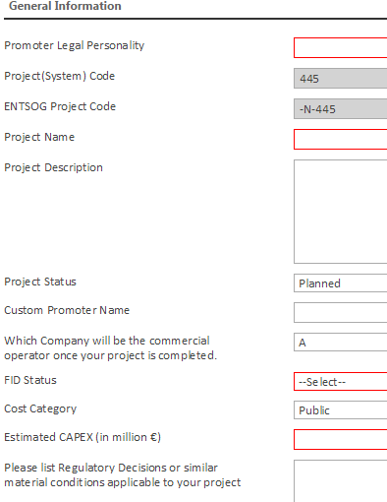
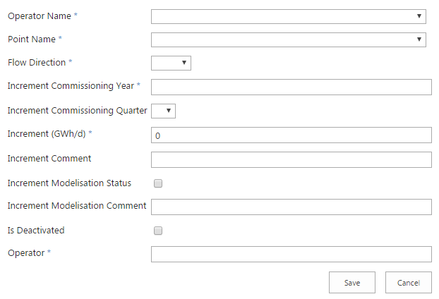
Data Portal Interface for submission
Live presentation of the Data Portal for Data Submission
  Project Creation, Modification, Submission, Increment Submission, etc.

Slide 10
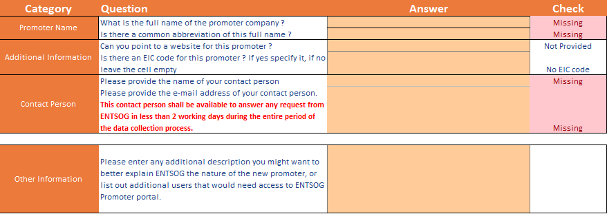
Presentation of Forms
  Promoter request form – to receive credentials to access the Data Portal

Slide 11
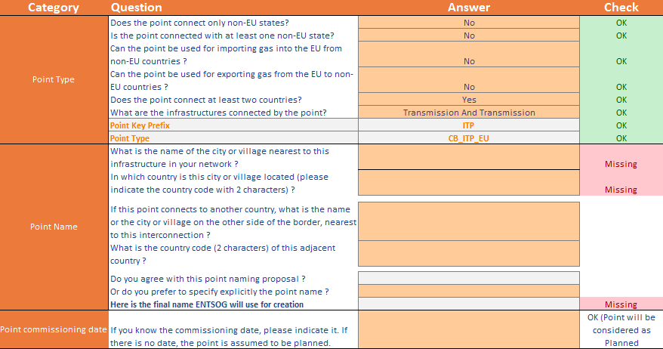
Presentation of Forms
  The Point creation form – to create new Points

Slide 12
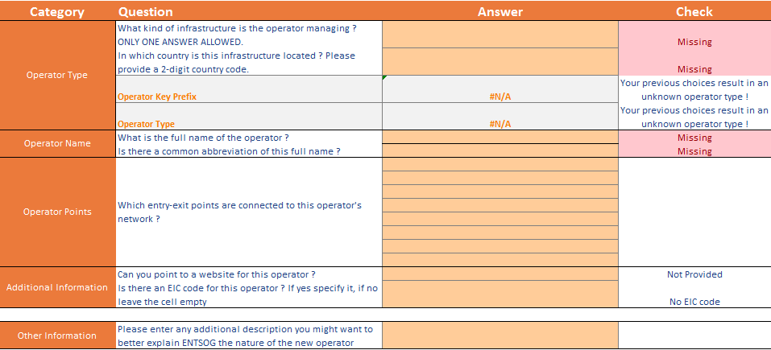
Presentation of Forms
  Operator creation form – to create new Operators

Slide 13
Self-assessment of investment needs
In line with the intetions of the COM to identify the investment gaps in the Regional Groups as a first step of the next PCI selection procedure, ENTSOG plans to:
  Include in the Project Questionnaire a section where the Promoter can self-assess the Project, by describing which investment need(s) -as indentified within the TYNDP 2015- does the Project fulfil

Slide 14
Ádám Balogh
Adviser, System Development
Celine.Heidrecheid@entsog.eu

