Slide 1
CBA Results Files
Getting started

Slide 2
Getting started
We highly encourage you to
  Read the CBA Methodology:
    Annex F on Methodology of TYNDP 2015
  http://www.entsog.eu/public/uploads/files/publications/TYNDP/2015/TYNDP022-150316_Annex_F_lowres.pdf
    And ESW-CBA Methodology
  http://www.entsog.eu/public/uploads/files/publications/CBA/2015/INV0175-150213_Adapted_ESW-CBA_Methodology.pdf
  Read the TYNDP 2015
  http://www.entsog.eu/publications/tyndp#ENTSOG-TEN-YEAR-NETWORK-DEVELOPMENT-PLAN-2015

Slide 3
Getting started
12 Result files for each Group of projects
  DISRUPTED RATE
  DISRUPTED QUANTITY
  REMAINING FLEXIBILITY
  INDICATORS
  MONETIZATION
  MARGINAL PRICE
  GPI
  FLOWS
  CO2 and demand
  IMPORT ROUTE DIV
  N-1 ESW CBA
  Economic Template
Modelling results
Capacity-based indicators results
Economic Template

Slide 4
Getting started
Units of the files
 | Units
DISRUPTED RATE | % of country (or balancing zone* ) demand | daily basis
DISRUPTED QUANTITY | GWh/d | daily basis
REMAINING FLEXIBILITY | % of country (or balancing zone* ) demand | daily basis
INDICATORS | SSPDi = % of supply price diversification on country Gas Bill | yearly basis
 | SSPDe= % of supply price dependence of country Gas Bill | yearly basis
 | USSD/CSSD= % of country demand on yearly basis | yearly basis
MONETIZATION | EUR/d | daily basis
MARGINAL PRICE | EUR/GWh
GPI | EUR/GWh
FLOWS | GWh/d | daily basis
CO2 and demand | CO2= in tons | daily basis
 | demand= in GWh | daily basis
IMPORT ROUTE DIV | no unit (HHI index)
N-1 | % of country demand | daily basis
Economic template | Bill components= 10^6 EUR/year | yearly basis
*: for country having more than 1 balancing zone

Slide 5
Overview of Modelling results
Reviewed!
 | Ref case | LNG |  | RU |  | NO |  | DZ |  | LY |  | AZ
 |  | ch | exp | ch | exp | ch | exp | ch | exp | ch | exp | ch | exp
DISRUPTED RATE DISRUPTED QUANTITY REMAINING FLEXIBILITY | Normal situation (NONE) |  |  | RU transit disruption |  | NO transit disruption |  | DZ transit disruption |  | LY transit disruption |  | AZ transit disruption
 |  |  |  |  | Ukraine |  | Langeled |  | Transmed |  | Green Stream |  | TANAP
 |  |  |  |  | Belarus |  | Franpipe |  | MEG
MONETIZATION MARGINAL PRICE GPI
INDICATORS: USSD/CSSD (supply dependence) |  |  | _LNG |  | _RU |  | _NO |  | _DZ |  | _LY |  | _AZ
INDICATORS: SSPDe_ (price dependence) |  |  | _LNG |  | _RU |  | _NO |  | _DZ |  | _LY |  | _AZ
INDICATORS: SSPDi_ (price diversification) |  | _LNG |  | _RU |  | _NO |  | _DZ |  | _LY |  | _AZ

Slide 6
Files structure
File | Worksheet
DISRUPTED RATE | START-END Values
DISRUPTED QUANTITY | START-END Values
REMAINING FLEXIBILITY | START-END Values
INDICATORS | START-END All Clusters
MARGINAL PRICE | START-END Values
GPI | START-END Values
Common File structure for these Files and Worksheets

Slide 7
Files structure (modelling results files)
Drop down list to select the results you want to look at
  DISRUPTED RATE
  DISRUPTED QUANTITY
  REMAINING FLEXIBILITY
  INDICATORS
  MONETIZATION
  MARGINAL PRICE
  GPI
Global context
Disruption scen
Infra. scen
Temporal period
Indicators
Price Conf.
Temporal period
Price Conf.

Slide 8
Modelling results - 1
Disruption and Remaining Flexibility
  No supply price configurations for these indicators
  Calculated at country (or BZ) level
  To be looked at under high demand situations: DC (=Design Case) and 2W (=2 weeks cold spell)
  Disruption Rate: measures the share of country’s demand which cannot be supplied
    A 0% disruption rate means the country is not facing disruption
    A 10% disruption on peak day means that the country’s infrastructures only allow to supply 90% of its peak demand
  Remaining Flexibility: measures the additional demand the country could cope with, expressed as share of the country’s actual demand
    A 20% remaining flexibility means the country could cope with a 20% increase of its demand
  Above indicators are also calculated under 8 route disruption scenarios (Ukraine, Belarus, …)
cf. Annex F on Methodology p22

Slide 9
Modelling results - 2
Monetized results
  Monetized results are calculated under the 13 price configurations
  EU Bill
  Marginal Price: by country (even by balancing zone)
    To be looked at for AW (=Average winter) and AS (=Average summer)
  GPI (Gas Price Index): proxy for the country gas Bills, calculated by country
    To be looked at for AW (=Average winter) and AS (=Average summer)
cf. Annex F on Methodology p15 to 18

Slide 10
Modelling results - 3
Indicators
  Indicators are calculated for each of the 6 supply sources.
  They are calculated at country level on a yearly basis
  Supply source dependence measures the share of country’s demand that cannot be supplied if EU faces a total absence of this source. It is calculated both under uncooperative (USSD) and cooperative (CSSD) behaviour between countries
    A country’s uncooperative dependence of 40% to LNG means that this country needs at least 40% of LNG to supply its demand, if not supported by other countries
  Supply price dependence (SSPDe) measures the dependence of country gas bill on that source
    A country’s price dependence of 40% to Norwegian gas means that an increase of 10% of Norwegian price would induce a 4% increase of the country’s gas bill
  Supply price diversification (SSPDi) measures the ability of each country to take advantage on a cheap source in its gas bill
    A country’s price diversification of 30% to Algerian gas means that a decrease of 10% of Algerian price would be reflected in a 3% decrease of the country’s gas bill
cf. Annex F on Methodology p23 to 26

Slide 11
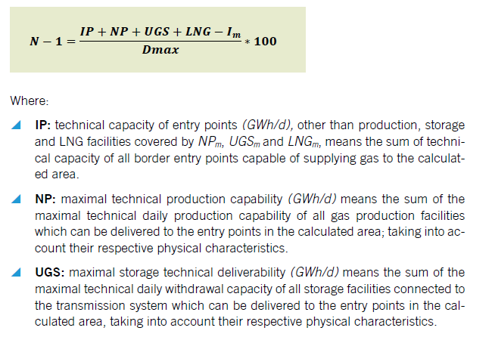
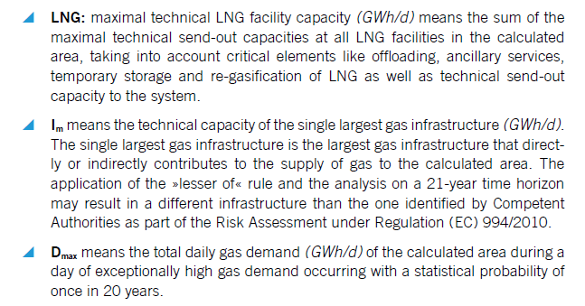
Capacity-based results – N-1
New!
  N-1 for ESW-CBA: calculation based on capacities and peak demand (non modelled)
cf. Annex F on Methodology p21

Slide 12
Capacity-based results – N-1
New!
  N-1_ESW-CBA Result file: impact of Group of projects provided
    By country
    In 2 worksheets
      N-1_green for GREEN global context (using countries’ GREEN peak demand)
      N-1_grey for GREY global context (using countries’ GREY peak demand)
    In these worksheets for the 2 Infrastructure scenarios
      Low Infrastructure scenario: lines 4 to 33
      High Infrastructure scenario: lines 36 to 65
    Detail by country to be found in the Countries Worksheets

Slide 13
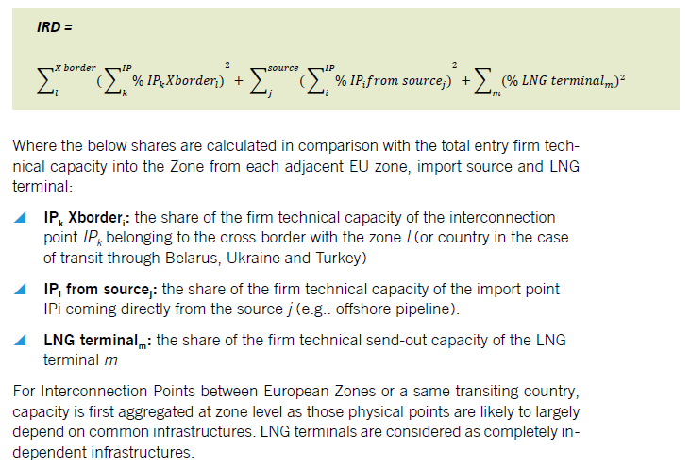
Capacity-based results - IRD
New!
  Import Route Diversification (IRD): HHI index which measures the diversification of paths that gas can flow through to reach a zone. Together with the Supply Source Price Diversification, it provides a proxy to the assessment of counterparty diversification.
cf. Annex F on Methodology p21

Slide 14
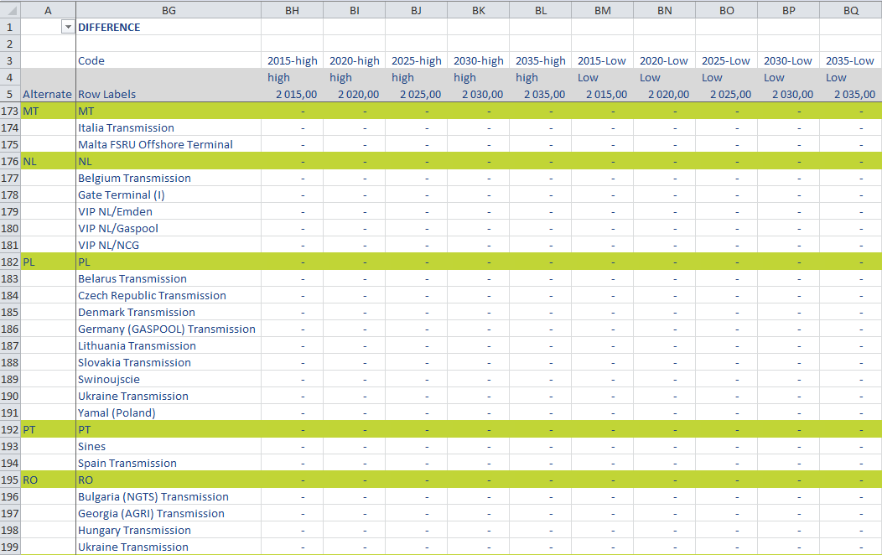
Capacity-based results - IRD
New!
  IMPORT ROUTE DIV Result File: impact of Group of projects provided
    in columns BG to BQ, under Infra Scenarios HUGH (BH to BL) and LOW (BM to BQ)
    by country (green lines)
Interpretation of figures
(50)= -50 = decrease
40 = +40 = increase
- = no impact

Slide 15
celine.heidrecheid@entsog.eu; adam.balogh@entsog.eu

