Slide 1
CBA Results Files
Filling in the templates

Slide 2
Getting started
We highly encourage you to
  Read the CBA Methodology:
    Annex F on Methodology of TYNDP 2015
  http://www.entsog.eu/public/uploads/files/publications/TYNDP/2015/TYNDP022-150316_Annex_F_lowres.pdf
    And ESW-CBA Methodology
  http://www.entsog.eu/public/uploads/files/publications/CBA/2015/INV0175-150213_Adapted_ESW-CBA_Methodology.pdf
  Read the TYNDP 2015
  http://www.entsog.eu/publications/tyndp#ENTSOG-TEN-YEAR-NETWORK-DEVELOPMENT-PLAN-2015

Slide 3
Overview of CBA
ENTSOG
Promoters
JRC
CBA
Fin. Template
FNPV
FRR
F C/B ratio
Capacity-based
Indicators (excl. Bidirect)
Qual. Template
Modelling results
Disruption rate
& Remaining Flexibility
JRC
Methodology
Indicators
Monetized results
(country level)
Econ. Template
ENPV
ERR
E C/B ratio
Monetization (EU level)

Slide 4
Result files – General information

Slide 5
Result files
12 Result files provided to all promoters for each Group of projects
  DISRUPTED RATE
  DISRUPTED QUANTITY
  REMAINING FLEXIBILITY
  INDICATORS
  MONETIZATION
  MARGINAL PRICE
  GPI
  FLOWS
  CO2 and demand
  IMPORT ROUTE DIV
  N-1 ESW CBA
  Economic Template
Modelling results
Capacity-based indicators results
Economic Template

Slide 6
Result files
Units of the files

Slide 7
Result files

Slide 8
CBA Templates
1 CBA (Economic + Qualitative + Financial) per Group of projects
  For each Group of projects, the same modelling results have been provided to all promoters in the Group of projects
  For each Group of projects, promoters have to coordinate to fill the Group CBA
    Share cost and revenue data to fill in the Economic and Financial Templates
    Discuss the modelling results to fill in the Qualitative Template

Slide 9
Economic Template

Slide 10
Economic Template
Benefits
  already filled in by ENTSOG
  In EPI_Calculation Sheet
  Based on monetized benefits referring to MONETIZATION
  Unit: 10^6 EUR/year
  Filled in for
    GREEN and GREY global contexts
    LOW and HIGH Infrastructure Scenario
    The 13 Price Configurations
Costs
  To be filled in by promoters
  In Inputs Sheet
  Aggregated CAPEX and OPEX for all projects within the Group of projects
  Unit: 10^6 EUR/year

Slide 11
Qualitative Template

Slide 12
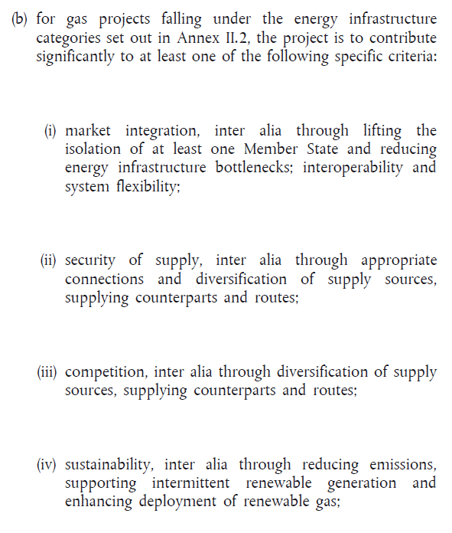
Qualitative Template – Section 2.
Group Benefits
  2 sub-sections, Specific Criteria and Other Benefits, based on TEN-E Regulation, Art 4 – 2 (b):

Slide 13
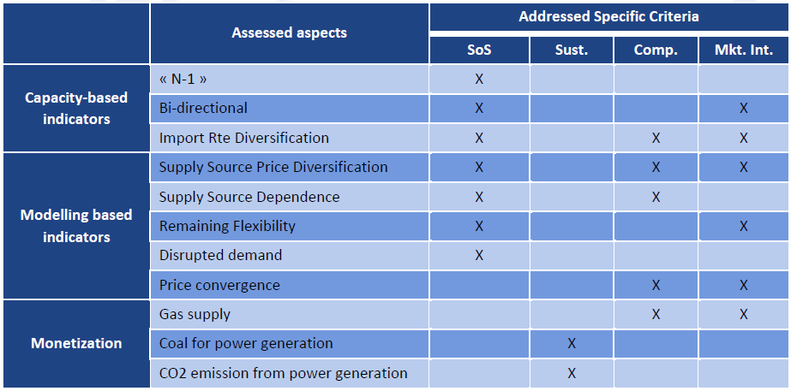
Qualitative Template – Section 2.
Specific criteria
  to fill in Specific criteria sub-section based on simulation results, refer to the below matrix of the ESW-CBA Methodology (**)
  (**) http://www.entsog.eu/public/uploads/files/publications/CBA/2015/INV0175-150213_Adapted_ESW-CBA_Methodology.pdf
Cf. ESW-CBA Methodology p64&65

Slide 14
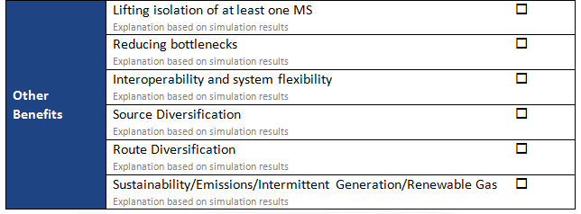
Qualitative Template – Section 2.
Apply to MS accessing a single supply source in the Initial Situation.
In such cases, Refer to increases in INDICATORS / SSPDi
Section 2. Group Description
In initial situation, bottleneck between 2 neighbouring countries (or BZ) are reflected by differences in the value of indicators.
In such cases, refer to decreased difference between 2 neighbouring countries for
INDICATORS : CSSD, SSPDe, SSPDi
MARGINAL PRICE
Refer to REMAINING FLEXIBILITY
Refer to increase in INDICATORS / SSPDi
Refer to decrease in IMPORT ROUTE DIV
CO2 Emissions: refer to decrease in tons of CO2 in CO2 and demand
Other items: refer to your answer to section 4.4. and 4.5. of the Qualitative Template

Slide 15
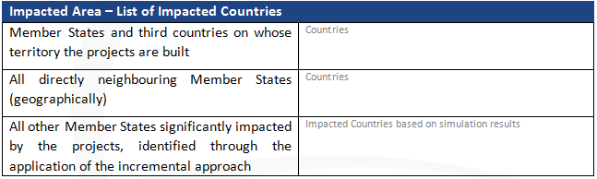
Qualitative Template – Section 4.1.
  Section 4.1. Identification of the significantly impacted countries and the Area of Analysis
Refer to Result Files providing results at country or balancing zone level to identify the Impacted Area based on simulation results

Slide 16
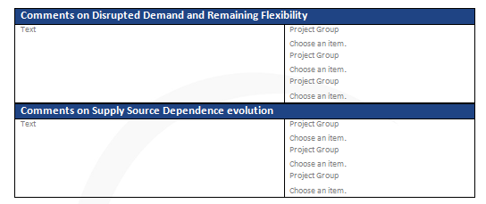
Qualitative Template – Section 4.2. (1/3)
Section 4.2. Comments on the Quantitative and Monetary Analysis of the TYNDP Step of ESW-CBA
Refer to
DISRUPTED RATE
DISRUPTED QUANTITY
REMAINING FLEXIBILITY
Under
- normal situation
- any meaningful route disruption scenario
Comment on
- complementarity with other projects
- competition with other projects
Refer to
INDICATORS
- CSSD (Cooperative Supply Source Dependence)
- and/or USSD (Uncooperative Supply Source Dependence)
For
- any meaningful supply source
Comment on
- complementarity with other projects
- competition with other projects

Slide 17
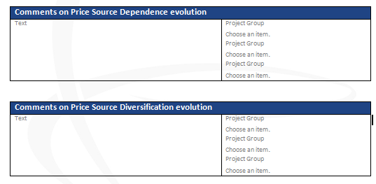
Qualitative Template – Section 4.2. (2/3)
Section 4.2. Comments on the Quantitative and Monetary Analysis of the TYNDP Step of ESW-CBA
Refer to
INDICATORS
- SSPDe (Supply Source Price Dependence)
For
- any meaningful supply source
Comment on
- complementarity with other projects
- competition with other projects
Refer to
INDICATORS
- SSPDi (Supply Source Price Diversification)
For
- any meaningful supply source
Comment on
- complementarity with other projects
- competition with other projects

Slide 18


Qualitative Template – Section 4.2. (3/3)
Section 4.2. Comments on the Quantitative and Monetary Analysis of the TYNDP Step of ESW-CBA
Refer to
MARGINAL PRICE
For any meaningful Price Configuration
Price convergence refers to the spread between EU countries Marginal Prices.
Comment on the impact of the Group on this spread, if any.
Comment on
- complementarity with other projects
- competition with other projects
Refer to
MONETIZATION (and potentially GPI)
For any meaningful Price Configuration
Comment on
- complementarity with other projects
- competition with other projects

Slide 19
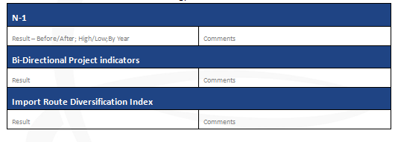
Qualitative Template – Section 4.3.
Section 4.3. Capacity Based Indicator Results and Comments
Refer to N-1 ESW CBA
Indicator to be calculated and commented upon by promoters
Refer to IMPORT ROUTE DIV

Slide 20
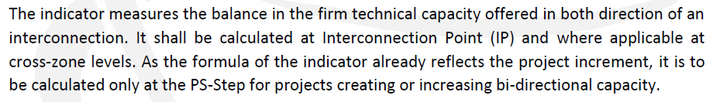
Qualitative Template – Section 4.3.
Bi-Directional Project Indicators (1/3)
  to be calculated by promoters
  Refer to ESW-CBA Methodology (**) p 34&35 http://www.entsog.eu/public/uploads/files/publications/CBA/2015/INV0175-150213_Adapted_ESW-CBA_Methodology.pdf
  2 indicators
    BDPi at Interconnection Point level
    BDPz at cross-zone level
  (**) http://www.entsog.eu/public/uploads/files/publications/CBA/2015/INV0175-150213_Adapted_ESW-CBA_Methodology.pdf

Slide 21
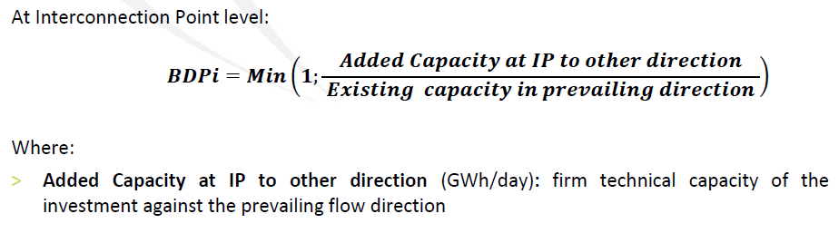
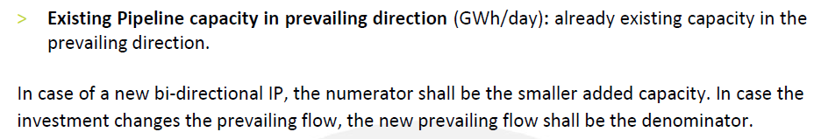
Qualitative Template – Section 4.3.
Bi-Directional Project Indicators (2/3)
  BDPi
Cf. ESW-CBA Methodology p34&35

Slide 22
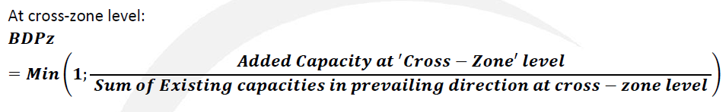
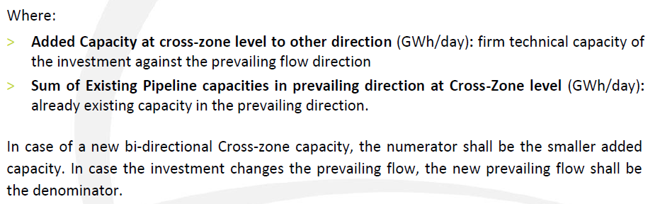
Qualitative Template – Section 4.3.
Bi-Directional Project Indicators (3/3)
  BDPz
Cf. ESW-CBA Methodology p34&35

Slide 23
Financial Template

Slide 24
Financial Template
No modelling results needed to fill in the Template
Explanations to fill in the template
  Refer to Tutorial Sheet included in the provided file

Slide 25
celine.heidrecheid@entsog.eu; adam.balogh@entsog.eu

