Slide 1
27/03/2023
1
CBA Methodology Process
ENTSOG Workshop on preliminary draft Cost-Benefit Analysis Methodology
Thilo von der Grün, Director System Development
Brussels

Slide 2

Context: revised TEN-E Regulation
Revised TEN-E Regulation (Art. 11) obliges ENTSOG and ENTSO-E to:
2023: Develop consistent single sector draft methodologies for a harmonized energy system-wide cost-benefit analysis at Union level for hydrogen (ENTSOG) and electricity (ENTSO-E) infrastructure
2025: Jointly submit to EC and ACER progressively integrated model including electricity, gas and hydrogen transmission
Consistent and uniform CBA methodologies across different energy infrastructure categories
Should be based on common assumptions and should consider sectorial specificities
Consistent with EU’s 2030 targets for energy and climate and 2050 climate neutrality objective
ENTSOG is currently developing its single sector cost-benefit analysis methodology (link)

Slide 3



Context: TEN-E criteria for Hydrogen infrastructure
Measure as contribution GHG emissions reductions
in various end-use applications
like industry and transport
Flexibility and seasonal storage options
for RES energy generation
Integration of renewable and
low-carbon hydrogen
Additional value of the project to the integration of market areas and price convergence
H₂
Market integration
and
interoperability
Sustainability
Competition
SoS
Additional value of the project to the resilience, diversity and flexibility of hydrogen supply
Contribution to supply diversification
Contribution of hydrogen infrastructure to TEN-E criteria

Slide 4


Context: Timeline of CBA Methodology process
Publication of ENTSOG's
preliminary draft CBA
methodology
Submission of draft CBA methodology to
EC, ACER
and Member States
Public.
final
CBA
method.
ACER opinion
Member States opinions
EC Approval
Adaptation for draft CBA methodology
3 months
Adaptation for final CBA methodology
3 months
3 months
Public consultation
12 weeks
Feb | Mar | Apr | May | Jun | Jul | Aug | Sep | Oct | Nov | Dec | Q1 2024
Following the public consultation and ACER/MS opinions, ENTSOG will adapt the CBA methodology

Slide 5
2. CBA consistency recommendations

Slide 6

Agency’s Position Paper on greater consistency of CBA methodologies
Background
The updated TEN-E Regulation (Regulation (EU) 2022/869) introduced the task of the development of separate CBA Methodologies for the various energy infrastructure categories set out in Annex II of the Regulation and by various entities:
  ENTSO-E → electricity transmission (including offshore grids)
  ENTSOG → H₂
  EC → energy storage, electricity smart grids, gas smart grids, electrolysers and CO₂ networks and facilities
The Agency is responsible to provide opinions on the ENTSO-E and ENTSOG CBA methodologies and on the draft lists of PCIs (which according to the TEN-E Regulation should focus on the consistent application of the criteria and the CBA across regions).
Also, the Agency has the task by the Regulation to promote the consistency of the methodologies developed by the EC with the methodologies elaborated by ENTSO-E and ENTSOG.
For this purpose, the Agency drafted a Position Paper indicating the topics where consistency should be promoted among all CBA methodologies and by all the parties involved.

Slide 7

Agency’s Position Paper on greater consistency of CBA methodologies
Points of required consistency of CBA methodologies
(without prejudice to further elements, which could be identified after the complete development of the CBA methodologies and their first implementation)
Common input data set and assumptions
Selection and use of scenarios and ways to deal with uncertainty
Length of assessment period, residual value of projects, and social discount rate
Definition of reference case networks
Treatment of interdependency with other projects
Project implementation status
Criteria to assess the plausibility of projects’ commissioning dates
Implementation Guidelines
Clustering rules
Definition and handling of capital and operational expenditures
Consideration of the impact of the future extreme weather events on infrastructure resilience
Approach to calculate social and environmental impacts of projects
Methodology to calculate the benefit-to-cost ratio and Net Present Value of projects
Sensitivities
Modelling interlinkages of CBA methodologies
Presentation of CBA results

Slide 8
Points of required consistency of CBA methodologies (1 – 4)
1. Selection and use of scenarios and ways to deal with uncertainty
  The project benefits should be calculated at least for all the joint scenarios developed by ENTSOs, and for all relevant time horizons: short-term (~up to 7 yr), mid-term (~ 10 yr), and long-term horizons (~15 yr).
2. Common input data and assumptions
  All CBA methodologies should be based on the joint scenarios developed by ENTSOs, and use consistent assumptions (if they are not defined in the scenarios) for benefits calculations (e.g. cost of CO2 and non-GHG, VoLL, cost of disruption of gas supply).
3. Length of assessment period, residual value of projects, and social discount rate
  All CBA methodologies should stipulate a 25-year assessment period (or align with the technical lifetime if less than 25 yr) and use a common social discount rate (e.g. 4%) with a residual project value of zero.
4. Definition of reference case networks
  The CBA methodologies should include consistent and clear rules for the short-term horizon and consistent criteria for the mid-term and long-term horizons.

Slide 9
Points of required consistency of CBA methodologies (5 – 8)
5. Treatment of interdependency with other projects
  If construction of reference case networks is required , the CBA methodologies should clarify how to handle interdependent projects (i.e., enablers , complementary and competing projects ) and provide the criteria for identifying them.
6. Project implementation status
  All CBA methodologies should consider the same project implementation stages for comparability of project maturity and to help an appropriate clustering: (1) Under consideration, (2) Planned but not yet in permitting, (3) In permitting, (4) Under construction
7. Clustering rules
  It must be clearly demonstrated why clustering is necessary; Common clustering rules should be stipulated for all CBA methodologies for avoiding excessive clustering, grouping together delayed investments with on-time ones, “under consideration” ones with planned investments, and competing projects together.
8. Criteria to assess the plausibility of projects’ commissioning dates
  When a single entity applies the CBA methodology on behalf of the project promoters, CBA methodologies should include criteria to assess the plausibility of project commissioning dates.

Slide 10
Points of required consistency of CBA methodologies (9 – 12)
9. Implementation Guidelines (IG)
  All CBA Methodologies should foresee issuing Implementation Guidelines, which shall include additional detailed information to be published in each assessment cycle (e.g. how the simulations are to be performed, the values of the parameters and the assumptions used); the main elements of the IG must be publicly consulted before they are decided.
10. Definition and handling of capital and operational expenditures
  CBA methodologies should include consistent definitions for the reported CAPEX and OPEX: i.e. which elements are included, how costs that occur at different points in time are considered, capital costs incurred before and after the project is commissioned, the year of reference for the reported CAPEX, and the cases in which CAPEX is based on standard investment costs.
11. Consideration of the impact of the future extreme weather events on infrastructure resilience
  CBA methodologies should factor in the impact of future extreme weather events in existing or new Security of Supply indicators, and SoS analysis should not be limited to the historical occurrence and impact of past events.
12. Approach to calculate social and environmental impacts of projects
  Consistency should be ensured in all CBA methodologies with regard to environmental benefits by aligning the indicators used to capture these benefits; additionally, a common methodological framework should be described for assessing the residual social and environmental impacts of projects under assessment, such as the project's impact on the local population and the project's local impact on nature and biodiversity.

Slide 11
Points of required consistency of CBA methodologies (13 – 16)
13. Methodology to calculate the benefit-to-cost ratio and Net Present Value of projects
  All CBA methodologies should define how to calculate the benefit-to-cost ratio and the NPV of projects and include all necessary information for replicating the calculations.
14. Sensitivities
  All CBA methodologies should include sensitivity analysis on critical parameters to account for the uncertainty involved in future projections of CBA results, as well as the framework for identifying the critical parameters.
15. Modelling interlinkages of CBA methodologies
  CBA methodologies should identify which indicators require an intersectoral approach, considering at least gas, hydrogen, and electricity sectors to capture interactions among projects and limit the risk of double counting benefits.
16. Presentation of CBA results
  All CBA methodologies should ensure that the costs, benefits and outcomes of CBAs are presented in a consistent way for all projects and for all scenarios.

Slide 12
3. Role of the scenarios in the CBA Methodology

Slide 13
Scenarios show contrasted possible futures
Today
Increasing range of uncertainty about the energy future
2023
2030
2035
2040
2050
Short-term Mid-term Long-term Very long-term
Role of the TYNDP scenarios

Slide 14
Storylines shape the hydrogen demand and supply patterns
Overall targets:
Reaching +1.5°C target with 66.7 % probability based on carbon budget
At least -55% GHG reduction in 2030; Carbon neutrality by 2050
Distributed Energy 2040 - 2050
De-centralised approach: Priority to European H2 production with decentralized RES
National energy and climate plans (NECPs), national hydrogen strategies
National Trends+ 2030 - 2040
Aggregation of national energy and climate policies to reach EU targets
Global Ambition
2040 - 2050
Centralised approach: H2 imports complementing European H2 production with centralised low carbon and RES options
TYNDP scenarios are intended to project the H2 supply and demand considering the ongoing energy transition

Slide 15





Energy efficiency is considered in the scenario building process
Annex V of revised TEN-E requires that energy efficiency first principle is applied in all the steps of TYNDP
By including energy efficiency in the Scenario process, it is subsequently considered in the later steps of TYNDP/PS-CBA processes
Energy demand complies with EU targets
Translated into input parameters
Technology
shares
Efficiency of
appliances
Renovation
rate
Efficiency
development
Role of the TYNDP scenarios

Slide 16

From storylines to hydrogen demand
Storylines setting the scene
Hydrogen demand development process
Energy efficiency
H2 annual demand EU27
NECPs
Commodity prices
H2 demand per country
Development of different sectors
H2 demand breakdown per sector
Evolution of technologies
Market shares of technologies
Monthly profile
Peak demand
EU policies
CO2 prices
Role of the TYNDP scenarios

Slide 17
Development process of hydrogen supply
Storylines & Demand drive the supply
Hydrogen supply development process
Import potentials
Import routes
Import prices
H2 annual supply EU27
H2 supply per country
H2 supply per source (domestic production or imports)
Monthly profile
Imports
Evolution of scenario-related H2 demand
NECPs
EU policies
Production cost
Production
Available production capacities
Role of the TYNDP scenarios

Slide 18
4. Infrastructure assumptions

Slide 19
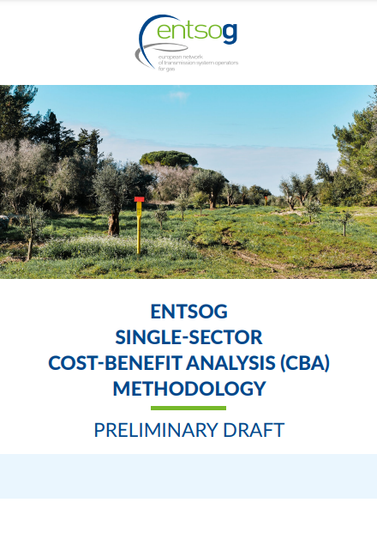


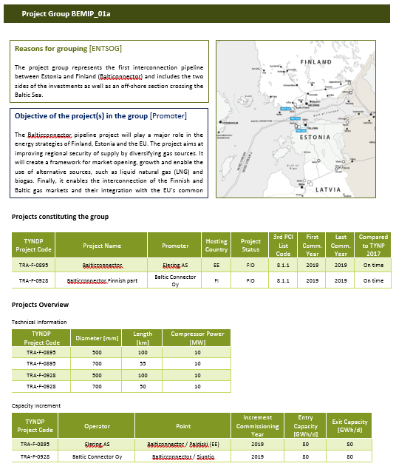
Objective of CBA Methodology
Each TYNDP/ PS-CBA process will be complemented by
Implementation Guidelines
TYNDP Assessment
Report
PS-CBAs
Detailed information regarding different elements impacting PS-CBA for each process is defined in the Implementation Guidelines
General Framework
Both TYNDP and PS-CBA assessment are carried out by ENTSOG following the CBA Methodology
2022
Assess Infrastructure needs
Assess
Projects
CBA Methodology will create a general framework that will be complemented with specific implementation guidelines

Slide 20
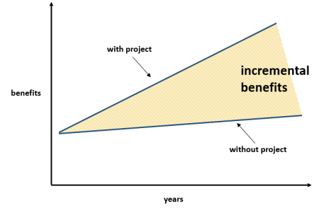
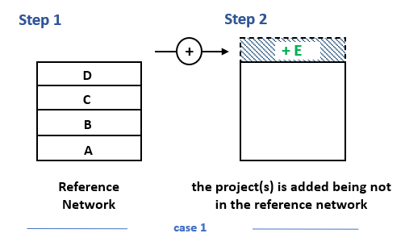
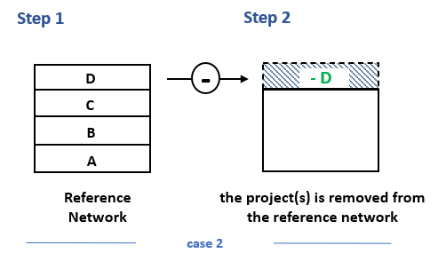
Reference infrastructure in the preliminary draft CBA methodology
Estimating benefits associated with projects require comparison of the two situations “with project” and “without project”
The counterfactual situation is the level of development of the hydrogen infrastructure against which the project is assessed: also called reference network
Reference networks will be used for the system and project-specific assessment, and therefore, underpinning the benefits of hydrogen infrastructure
PINT
TOOT
Contrasted reference(s) network(s) will ensure a robust assessment of hydrogen infrastructure

Slide 21


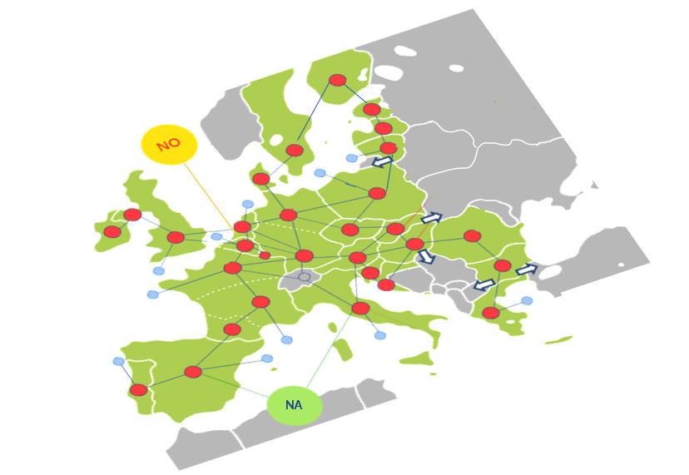
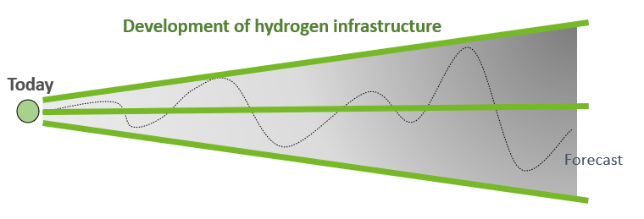
Reference infrastructure in the preliminary draft CBA methodology
Assessment of hydrogen infrastructure will require definition of reference network for the different energy infrastructure categories interlinked:
Hydrogen Natural gas Electricity
Interlinkages between hydrogen, electricity and natural gas
Hydrogen infrastructure development is highly dependent on the evolution of hydrogen demand – supply
Contrasted reference(s) network(s) will ensure a robust assessment of hydrogen infrastructure

Slide 22
Reference infrastructure in the preliminary draft CBA methodology
For hydrogen and natural gas reference network, TYNDP/PCI/PMI data collection of existing and planned projects plays a very import role
Reliable and detailed project information
Cross-border capacities between countries
Cross-border off-shore capacities
Transmission capacities within the country
Storages: injection/withdrawal capacities, WGV, injection/withdrawal curves
Hydrogen Import terminals: injection capacities into the grid yearly/peak, storage volumes
For repurposing projects: expected impact on natural gas infrastructure
Cross-border capacities between countries
Intra-country capacities
Storages: injection/withdrawal capacities, WGV, injection/withdrawal curves
LNG Import terminals: injection capacities into the grid, storage volumes
Contrasted reference(s) network(s) will ensure a robust assessment of hydrogen infrastructure

Slide 23
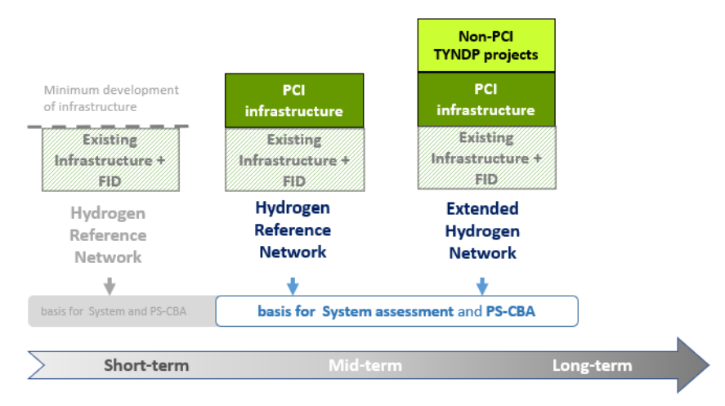
Hydrogen reference infrastructure
Existing network: can only be considered once in place
PCI: Hydrogen reference network based on 1st PCI list under revised TEN-E
Extended network: project-based infrastructure level based on TYNDP project submissions
― Less
Infrastructure development in the reference network
+ More
TYNDP and PCI project submissions as basis for hydrogen reference network
Contrasted reference(s) network(s) will ensure a robust assessment of hydrogen infrastructure

Slide 24
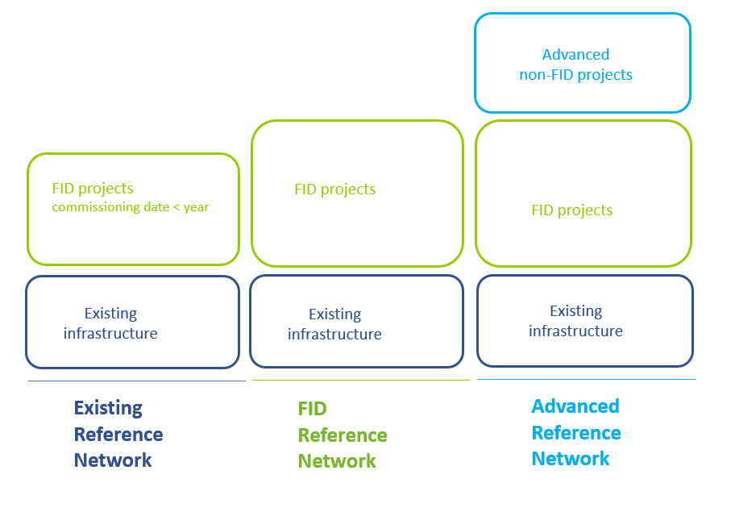
Natural gas reference infrastructure
Existing network: includes the existing infrastructure and FID projects close to be commissioned
FID: Includes the existing reference network and all FID projects
Advanced network: includes FID reference network and non-FID projects that fulfil the conditions to be classified as advanced projects
― Less
Infrastructure development in the reference network
+ More
Given the interlinkages between natural gas and hydrogen, it is important to capture in the assessment future evolution of natural gas infrastructure, including the effect of repurposing of NG infrastructure for hydrogen transport

Slide 25
Electricity reference network
For dual assessment hydrogen - electricity
Electricity reference grid will be defined as in ENTSO-E relevant TYNDP/PS-CBA process
The reference network consists of the already existing grid, and the projects that have a strong chance of being implemented by the dates considered in the scenarios.
The reference network is published as part of the ENTSO-E TYNDP process
Reference network should include only those projects whose timely commissioning is reasonably certain:
  a) Projects in construction phase
  b) Projects that successfully completed EIA
  c) Projects in permitting or planned phase and their timely realisation is most likely
Different reference grids depending on the time horizon: mid-term horizon, long-term horizon, very long-term horizon

Slide 26
5. Modelling of hydrogen infrastructure

Slide 27
5. 1 Interlinkages H2-electricity

Slide 28
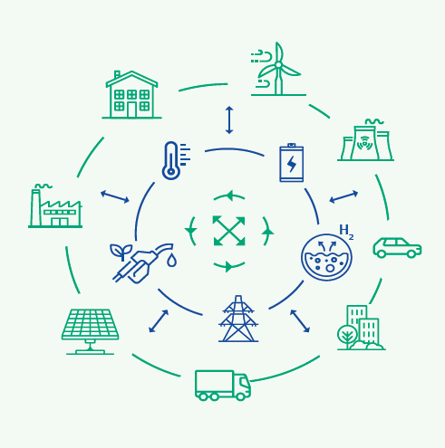
Energy system wide cost-benefit analysis
10. By 24 June 2025, […], the ENTSO-E and the ENTSOG shall jointly submit to the Commission and the ACER a consistent and progressively integrated model that will provide consistency between single sector methodologies based on common assumptions including electricity, gas and hydrogen transmission infrastructure as well as storage facilities, liquefied natural gas and electrolysers, […] drawn up in line with the principles laid down in Annex V.
11. The model referred to in paragraph 10, shall cover at least the relevant sectors’ interlinkages at all stages of infrastructure planning, specifically scenarios, technologies and spatial resolution, infrastructure gaps identification in particular with respect to cross-border capacities, and projects assessment.

Slide 29
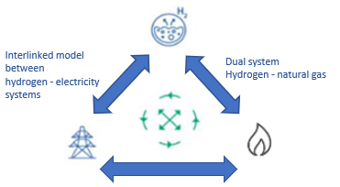
Electricity – Hydrogen Interlinked Model
The current interlinked model is used to model electricity and hydrogen
The next phase of development for the ILM is the addition of natural gas system

Slide 30
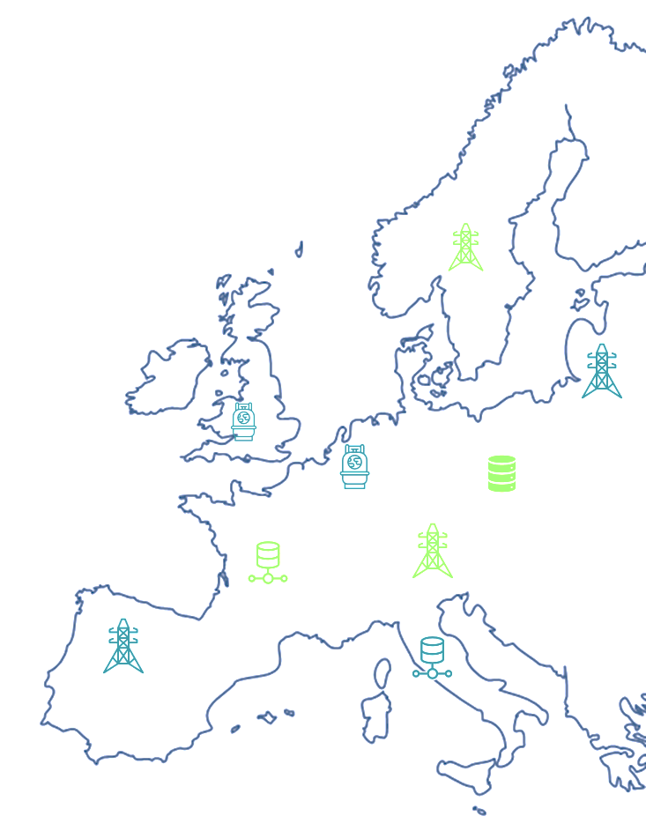
ILM Modelling Approach
SRES
(CH4-)Demand = H2
2. H2-Demand, Tank Storage
3. H2-Demand, SMR
Electricity Market
Generation Capacity
Infrastructure
Demand
P2G
YY00 national
H2-grid
Salt Cavern Storage
YY00 national
H2-grid
Salt Cavern Storage
P2G
P2G
SRES
XX
H2-imports
DRES

Slide 31
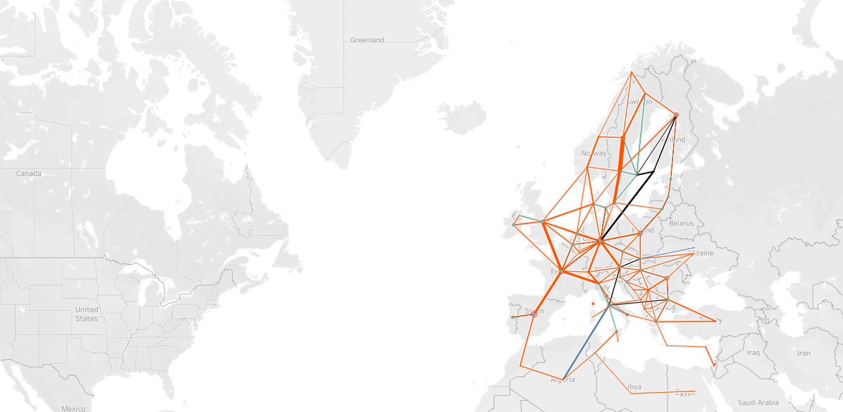
Model Development: Infrastructure Levels
Infrastructure levels
The electricity reference grid used is developed by ENTSO-E
The hydrogen infrastructure level used is developed by ENTSOG
Storage Levels
Reference hydrogen storage levels have been collected from the gas TSOs
Hydro and battery storages are taken from the scenarios
Imports
Hydrogen imports are considered at specific import points

Slide 32

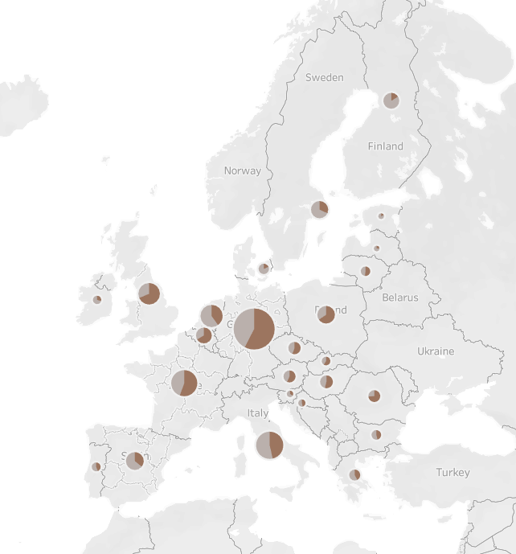
Example of Location of Electrolysers
Extract from DE2030
There are 2 zones in the hydrogen model
Zone 1: electrolysers outside hydrogen market
Zone 2: electrolysers connected to hydrogen market
In the sample scenario there are more electrolysers in zone 1
As demand connects to the hydrogen market (zone 2), so will electrolyser capacity

Slide 33
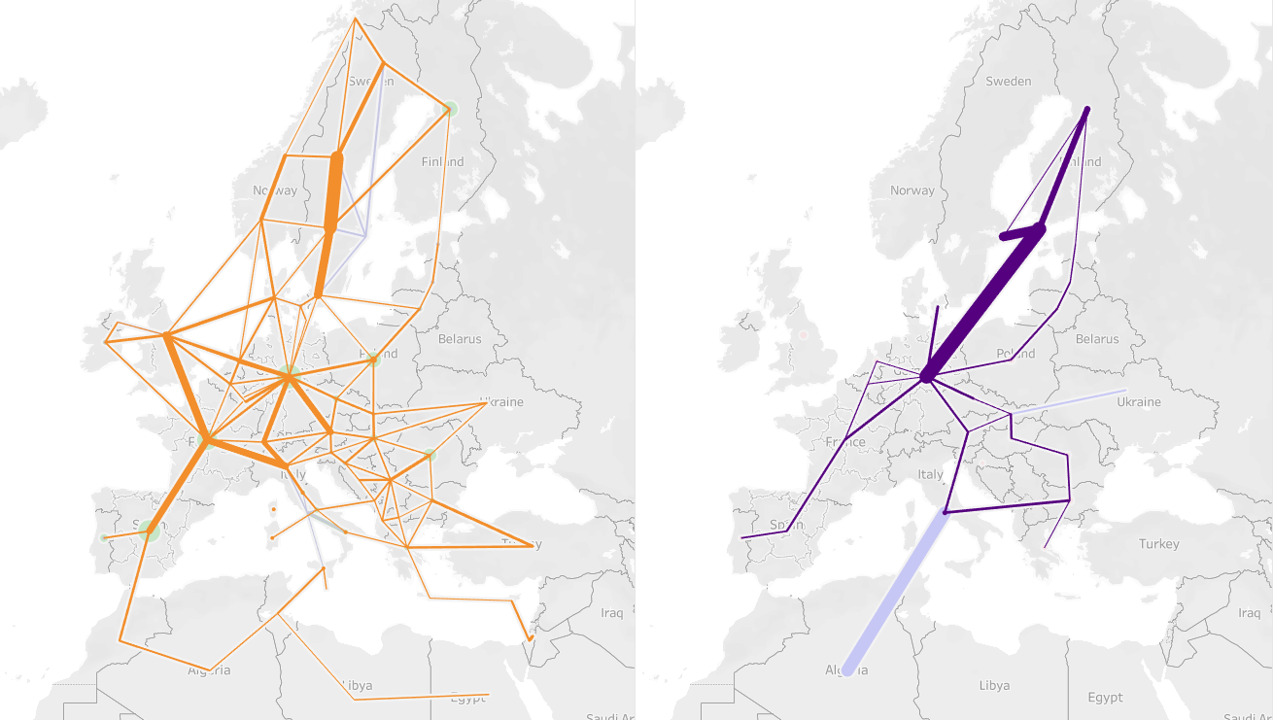
Example of Infrastructure Levels
Electricity
Hydrogen

Slide 34
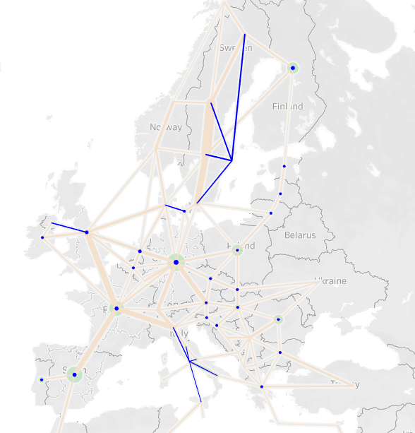
Hydrogen vs. Electricity Topology
The topologies of the models must be aligned.
The electricity model uses the electricity bidding zone topology
The hydrogen zones are typically 1 node per country
Each electricity bidding zone is connected to the home hydrogen node
This is done for Sweden, Italy and Denmark

Slide 35
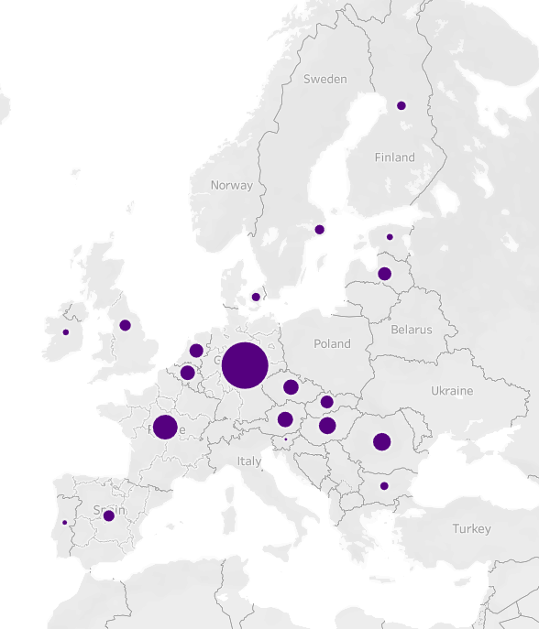
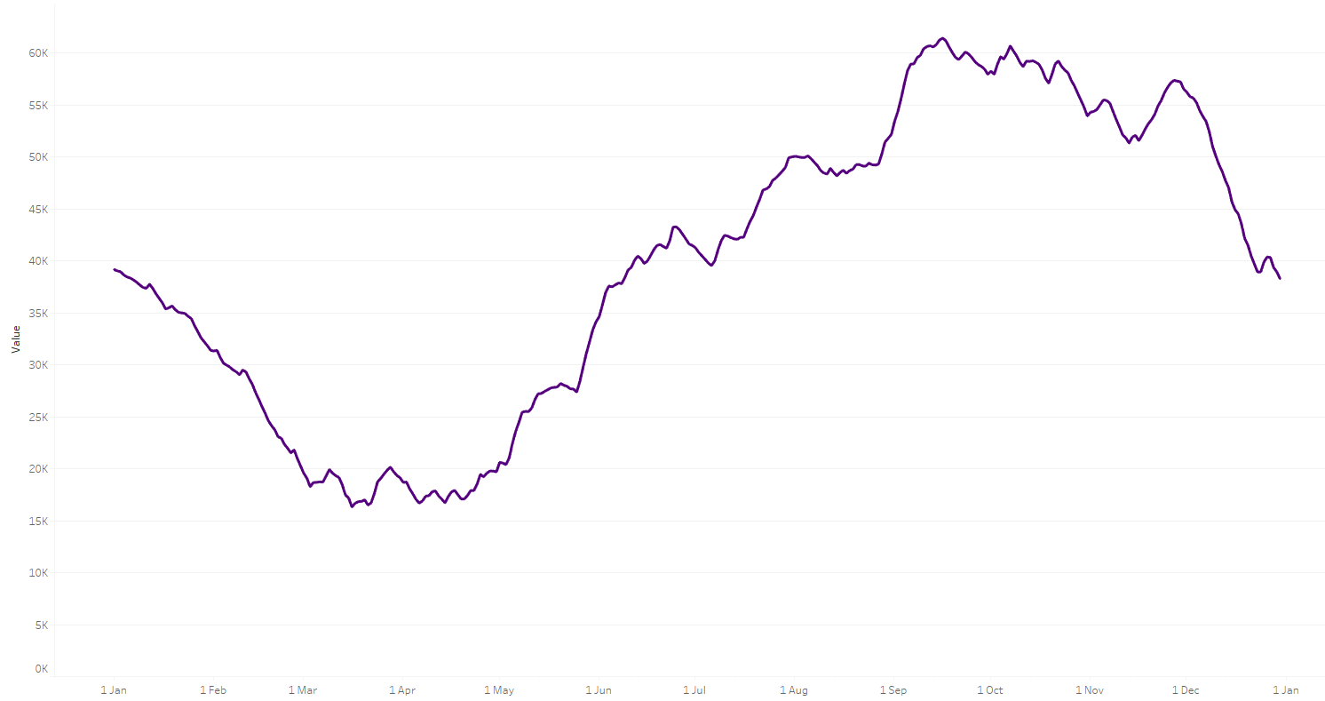
Example of Hydrogen Storages Locations
These storage levels are extracted from one of the infrastructure levels
Storage levels start partially filled and must end at the same level
Storages have short term cycles and long term cycles due to the variability of RES

Slide 36

Model Development: Hydrogen CCGTs
H₂ CCGT
In the scenarios, H₂ CCGTs are not assigned in the models, but postprocessed after the gas for generation consumption has been established
In the interlinked model, the split between H₂ CCGTs and CH₄ CCGTs is added into the model. This means the H₂ CCGTs can be connected to the hydrogen node
This is important as there are limitation to the hydrogen system which is influencing the amount of energy which can be supplied to the CCGTs (unlike the CH₄ CCGTs)

Slide 37
5. 2 Interlinkages H2 - Natural gas

Slide 38
Dual assessment of Hydrogen and Natural gas infrastructure
Dual assessment to capture interlinkages between hydrogen and natural gas infrastructure:
Hydrogen production from natural gas with thermal processes (e.g., SMR)
Impact of hydrogen infrastructure on the natural gas network (i.e., repurposing of natural gas infrastructure)
Dual assessment for Hydrogen and NG infrastructure to capture interlinkages between energy carriers

Slide 39
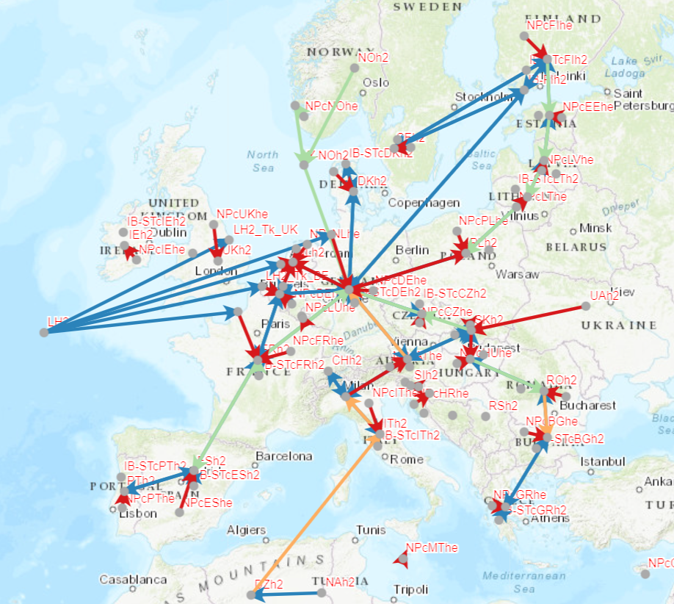
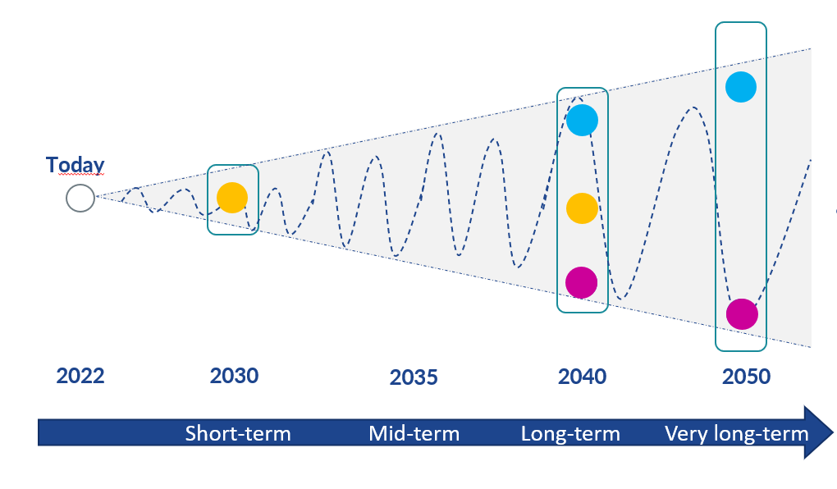
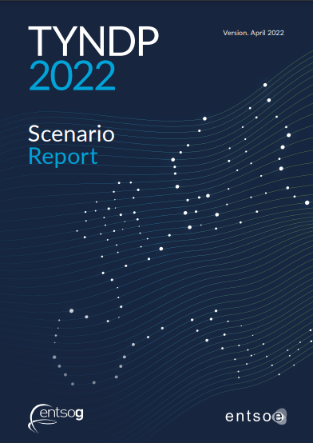
Dual assessment of Hydrogen and Natural gas infrastructure
Supplies
Demand
Flow modelling aims at balancing supply and demand at the lower carbon content

Slide 40

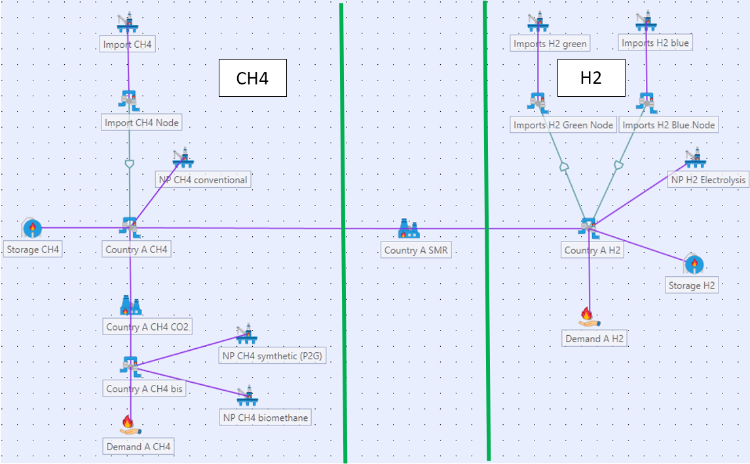
Dual assessment of Hydrogen and Natural gas infrastructure
Focus on modelling:
Model for dual assessment of Hydrogen and Natural Gas infrastructure

Slide 41

Dual assessment of Hydrogen and Natural gas infrastructure
There are two types of constraints in the model:
Hard constraints: constraints that the model has to respect whatever the consequences (even if it leads to the absence of solution)
capacity, working gas volume, maximum supply potential…
Soft constraints: parameters that the model will incorporate to find the “best” solution. They are “constraints” because they put some restrictions on what can be the best solution. But they are also “soft” because the model can still use the related quantity, even if it increases the cost of the solution. These soft constraints are price/cost related.
Cost of curtailment, storage target penalty, CO2 cost, supply price, infrastructure residual costs…

Slide 42
Dual assessment of Hydrogen and Natural gas infrastructure
CO₂ merit order and impact on the supply use
H₂ demand will be satisfied
  first by Electrolysis production and Green H2 imports,
  and then by blue H2 imports or SMR use within EU
Natural gas demand will be satisfied
  first by biomethane and P2G methane,
  and then by conventional National Production and imports.
Higher CO₂ emissions factor
Higher CO₂ emissions factor

Slide 43
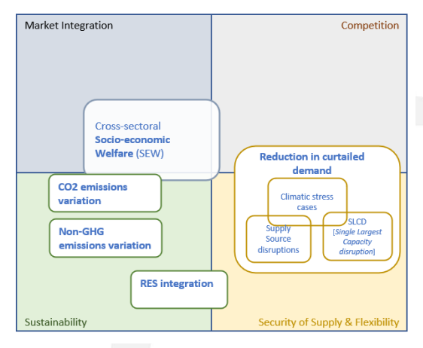
Dual assessment of Hydrogen and Natural gas infrastructure
TEN- E criteria
Dual assessment of Hydrogen and Natural gas infrastructure is proposed to capture Security of Supply and flexibility benefits of Hydrogen infrastructure
Benefits in the broad-sense, it is important to capture interlinkages/ impact with Natural Gas infrastructure
Dual assessment for Hydrogen and NG infrastructure to capture interlinkages between energy carriers

Slide 44
6.1 Benefits of hydrogen infrastructure (Interlinkage H2-electricity)

Slide 45

ILM dual CBA Process Overview
Scenario Expansion Model
Demand
Generation Capacity
Electrolyser Capacity
Project
Take out one at a time (TOOT)
Put In at a time (PINT)
Common Indicators
H₂ + Electricity dispatch model
System Assessment / Base Run
Projects Impact
Global SEW
RES Integration
CO2 emissions
CBA
Reference Networks
(H2 and electricity)
45
ILM TF

Slide 46
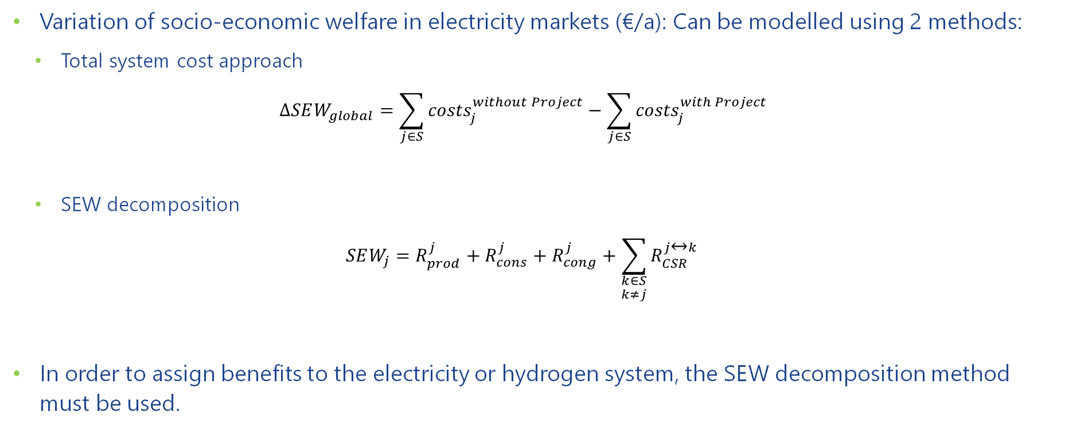
Cost Benefit Analysis – Social Economic Welfare
Variation of socio-economic welfare in electricity markets (€/a): Can be modelled using 2 methods:
  Total system cost approach
  $$ΔSEW_{global}=\sum_{j∈S}{{costs}_{j}^{without Project}}−\sum_{j∈S}{{costs}_{j}^{with Project}}$$
  SEW decomposition
  $$SEW_{j}=R_{prod}^{j}+R_{cons}^{j}+R_{cong}^{j}+{\sum_{\begin{aligned}k∈S \\ k≠j\end{aligned}}^{ }{R_{CSR}^{j↔k}}}_{ }^{ }$$
In order to assign benefits to the electricity or hydrogen system, the SEW decomposition method must be used.

Slide 47
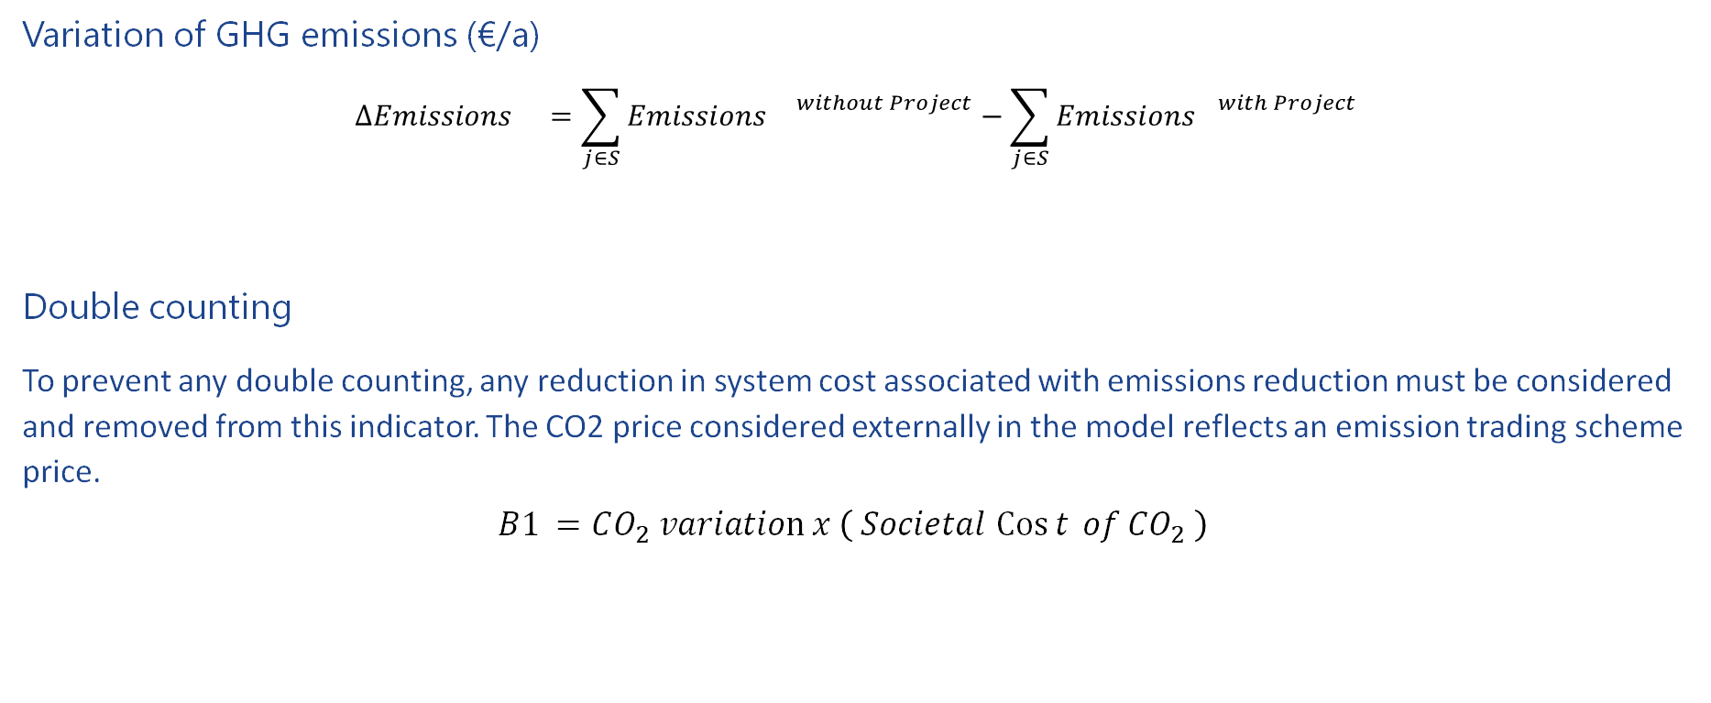
Cost Benefit Analysis – Variation of GHG emissions
Variation of GHG emissions (€/a)
$$Δ{Emissions }_{}=\sum_{j∈S}{{{Emissions }_{}}_{}^{without Project}}−\sum_{j∈S}{{{Emissions}_{}}_{}^{with Project}}$$
Double counting
To prevent any double counting, any reduction in system cost associated with emissions reduction must be considered and removed from this indicator. The CO2 price considered externally in the model reflects an emission trading scheme price.
$$B1 =CO_{2} variation x \left( Societal \operatorname{Cos}{t} of CO_{2} \right)$$

Slide 48

Cost Benefit Analysis – Variation of electricity RES curtailment
Variation of electricity RES curtailment (€/a): difference in curtailed RES with and without the project
  This indicator measures the reduction of renewable generation curtailment in MWh (avoided spillage) and/or the additional amount of RES generation that is connected by the project in MW.
$$ΔRES Curtailment=\sum_{j∈S}{{RES Curtailment}_{}^{without Project}}−\sum_{j∈S}{{RES Curtailment}_{}^{with Project}}$$

Slide 49
6.2 SOS benefits of hydrogen infrastructure

Slide 50
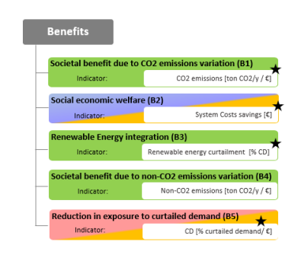

SoS benefits of Hydrogen infrastructure
SOS
Reduction in Curtailed Demand
Indicator for H2:
CR [% of demand ]
Single Largest Capacity
Indicator for H2:
CR [% of demand ]
S-1
Indic. for H2:
CR [% of demand]
Dual assessment for hydrogen and NG infrastructure to capture SoS benefits of hydrogen infrastructure

Slide 51
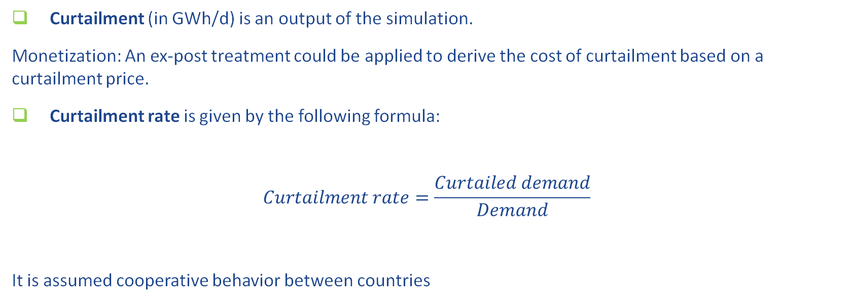
SoS benefits of Hydrogen infrastructure
Curtailment (in GWh/d) is an output of the simulation.
Monetization: An ex-post treatment could be applied to derive the cost of curtailment based on a curtailment price.
Curtailment rate is given by the following formula:
$$Curtailment rate=\frac{Curtailed demand}{Demand}$$
It is assumed cooperative behavior between countries
Country/ Area LEVEL

Slide 52




SoS benefits of Hydrogen infrastructure
1 objective function:
Ensure supply/demand balance minimizing CO2 emissions
Climatic stress cases
Yearly average conditions
Monthly profiles
Peak Day
1-in-20 years
2-week cold spell
1-in-20 years
2-week Dunkelflaute
1-in-20 years
Simulation cases
No supply stress
No supply stress
Supply stress
Infrastructure disruption (SLCD)
Supply stress (S-1)
indicator
Curtailment rate (yearly)
Curtailment rate peak
SLCD (peak)
S-1 (peak)
Curtailment rate 2-week
S-1 (2-week)
Curtailment rate 2-week DF
S-1 (2-week DF)
Dual assessment for hydrogen and NG infrastructure to capture SoS benefits of hydrogen infrastructure

Slide 53
7. PS-CBA assessment

Slide 54
Framework and assumptions in the PS-CBA: grouping
PROJECT GROUPING
PS-CBA assessments are performed to individual projects or, in most cases, to a group of projects
Projects are group based on functional criteria:
  Hydrogen interconnection between two (or more) countries
  Import terminal and connecting pipeline to the hydrogen grid
  Underground storage and connecting pipeline to the hydrogen grid
  A connection to an extra-EU hydrogen supply source
Grouping of projects should be based on functional and objective criteria

Slide 55
Framework and assumptions in the PS-CBA: grouping
Consideration of enablers and complementary projects:
Competing projects should always be grouped separately
Enhancer project should be grouped with the main investment (additional group to capture the incremental benefit of the enhancer)
In case of several phases of a project, each phase should be assessed separately
Enabler project should be grouped with the enabled project

Slide 56
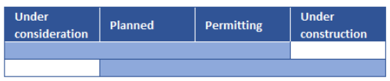
Framework and assumptions in the PS-CBA: grouping
Additional considerations for grouping
Investments can only be grouped together if they are at maximum two advancement status apart from each other
Commissioning dates do not differ by more than a certain number of years (i.e., 10 years)
Rules for grouping of hydrogen projects should be flexible enough in accordance with the level of infrastructure development

